Slide 1
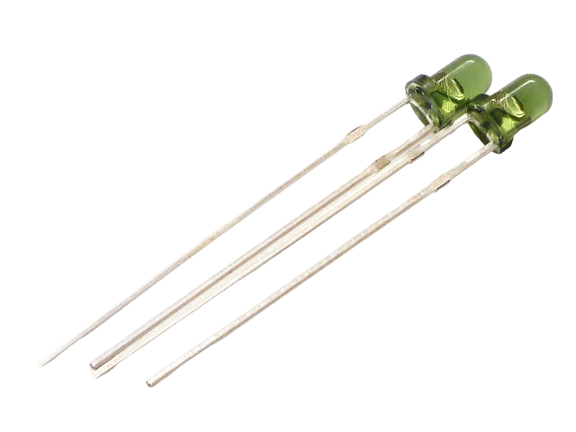



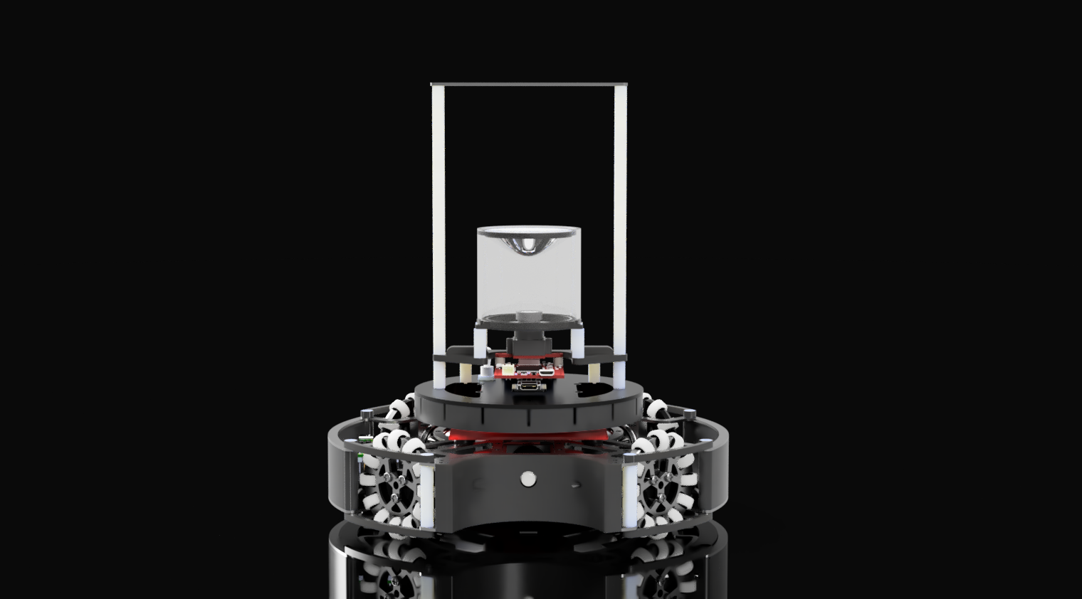
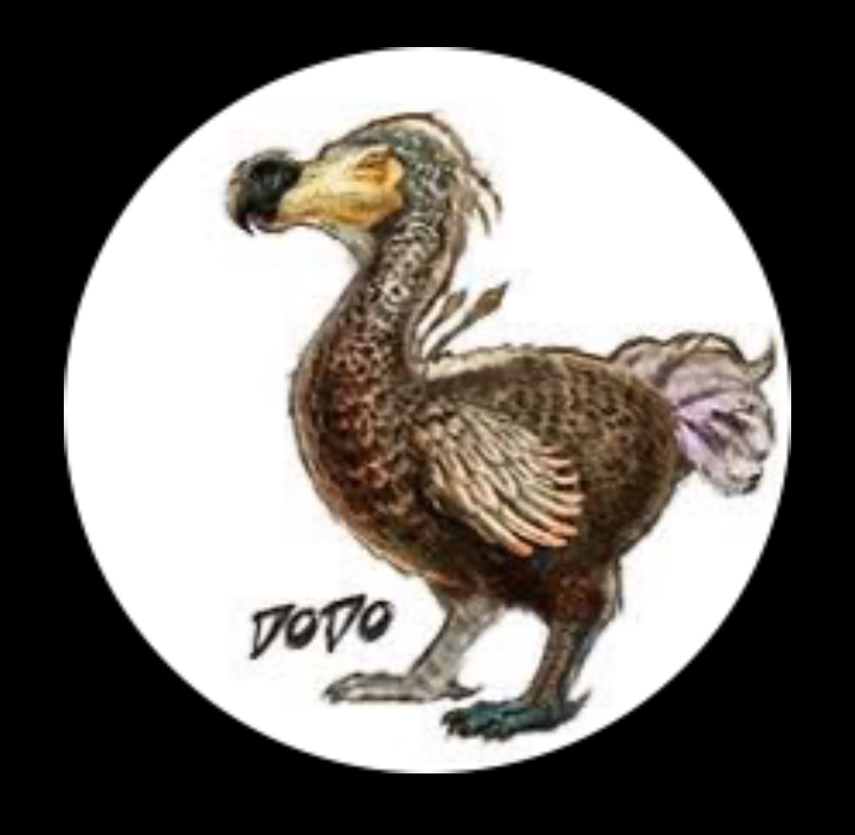


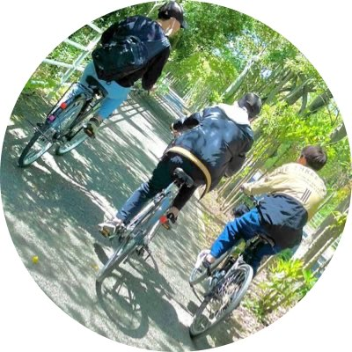

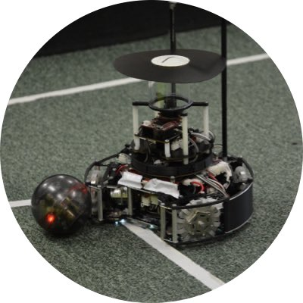



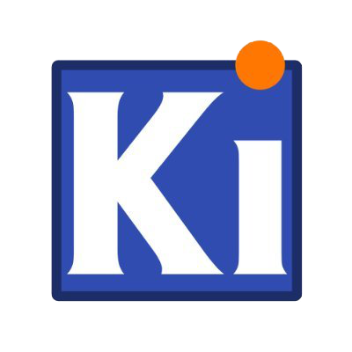

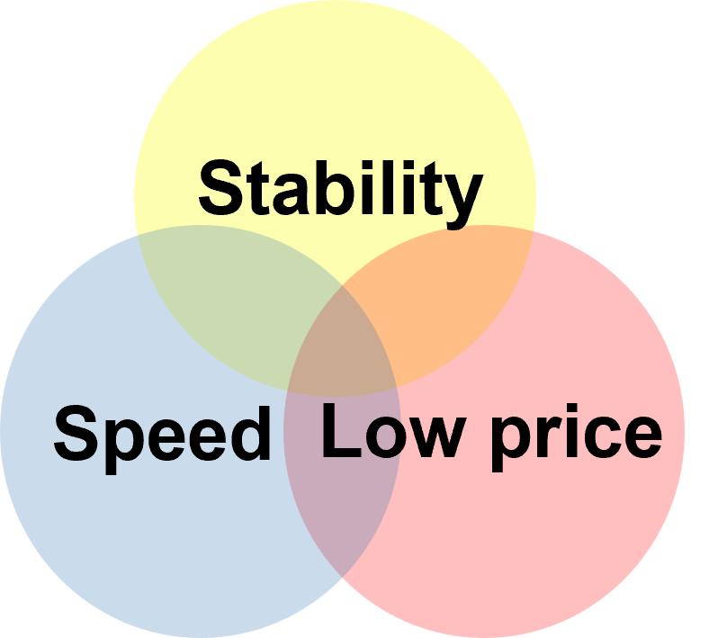




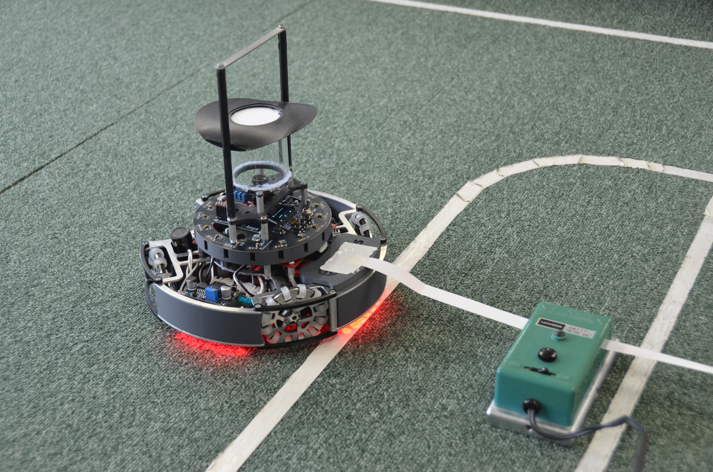
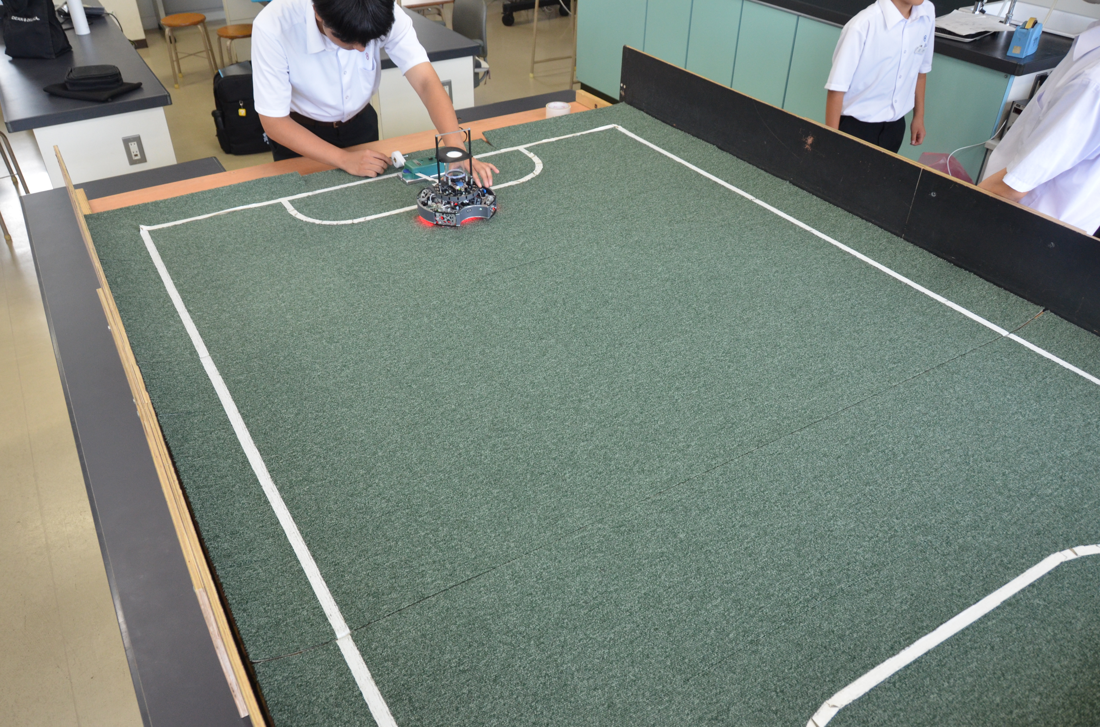
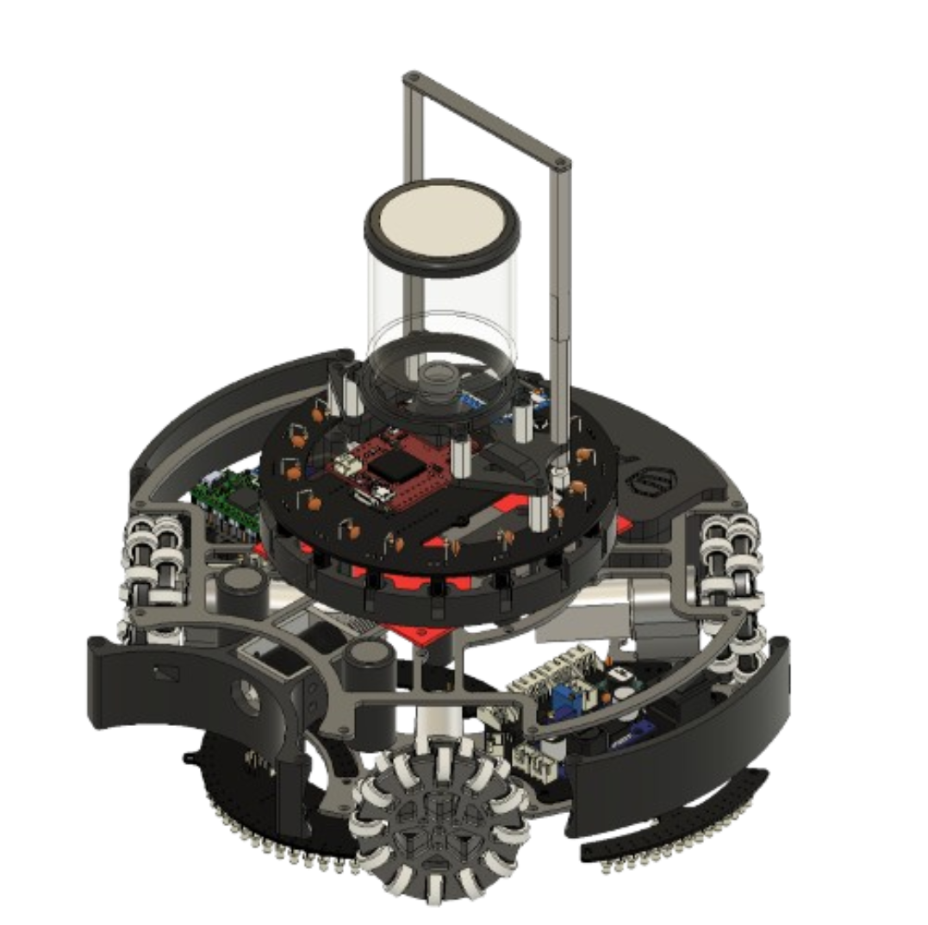
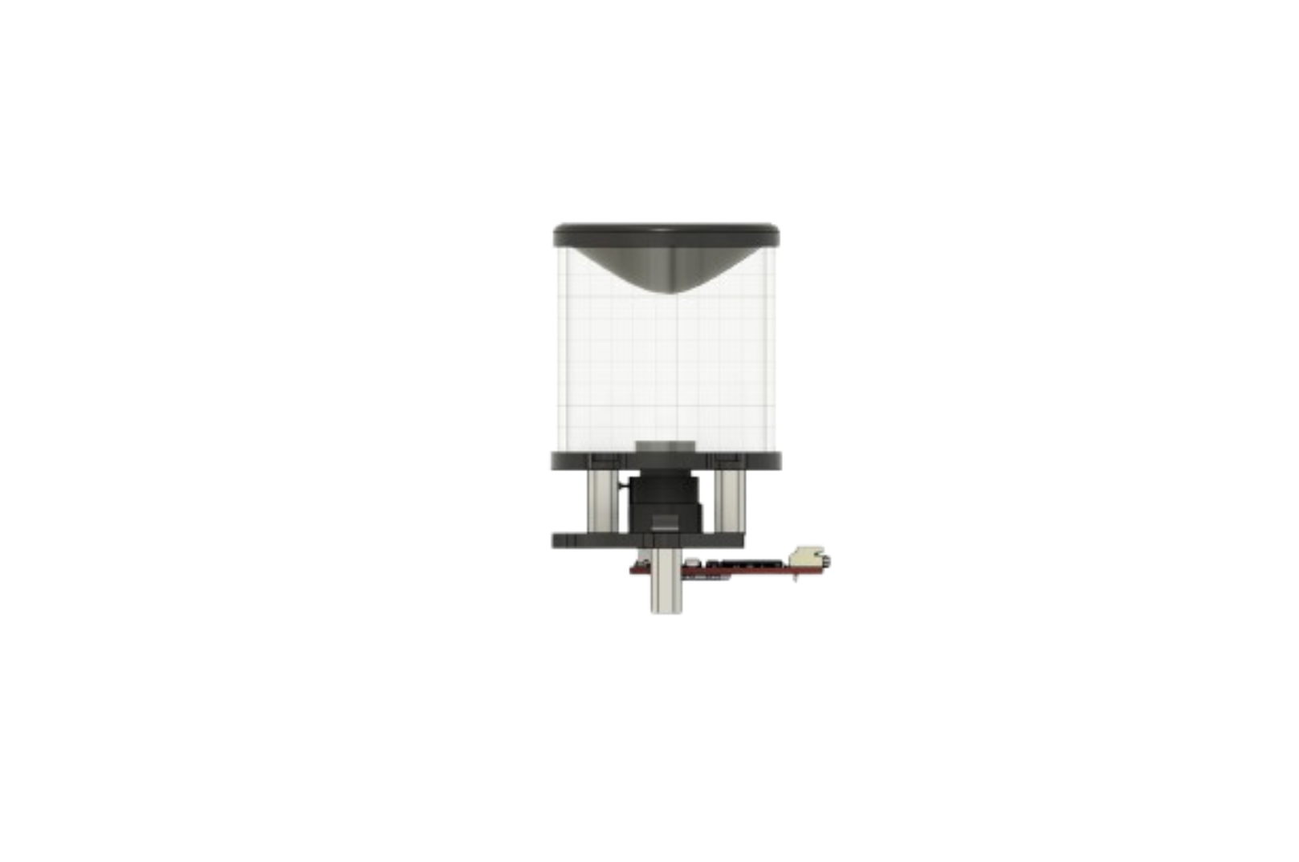
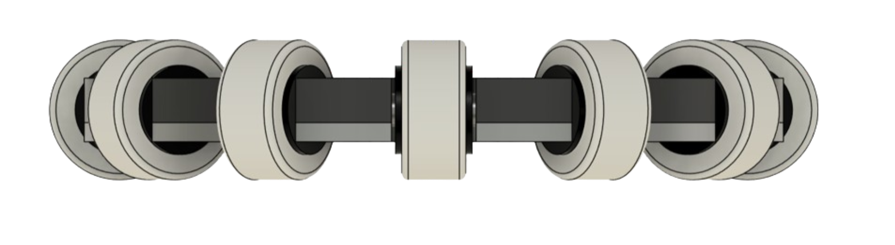
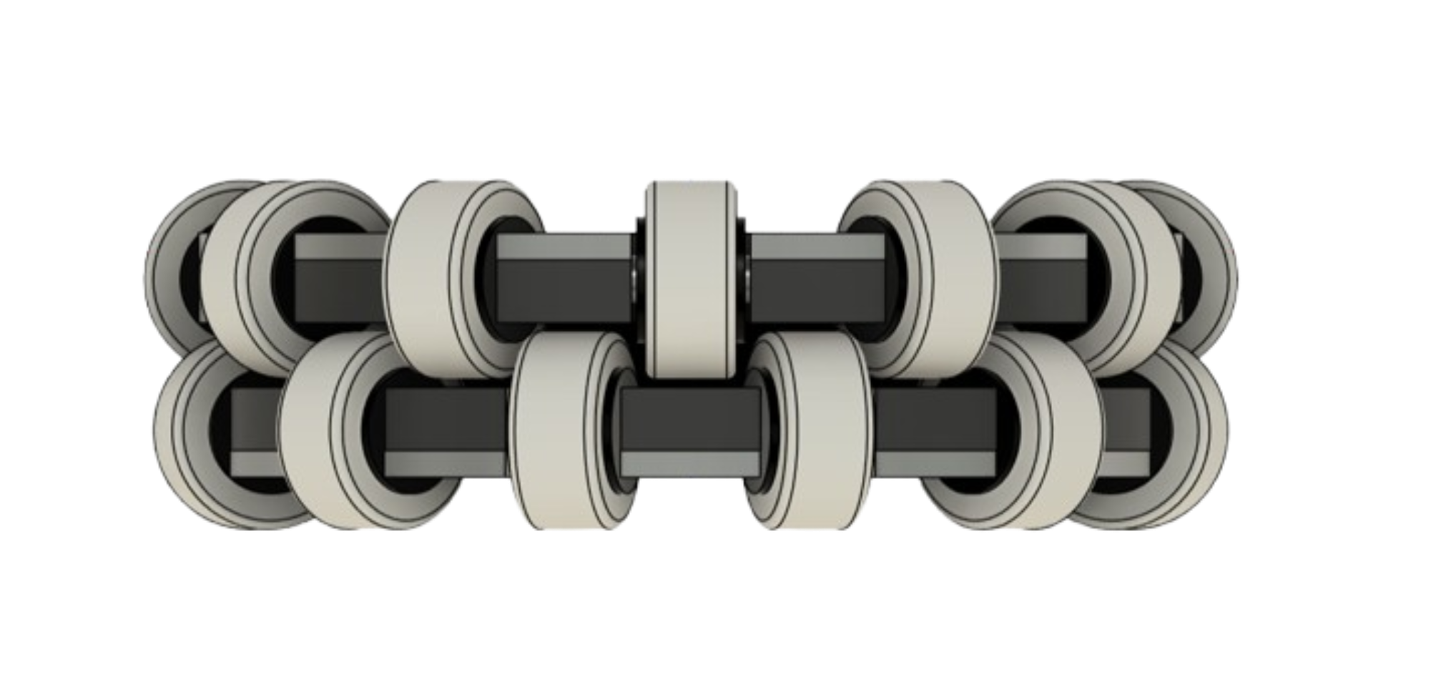
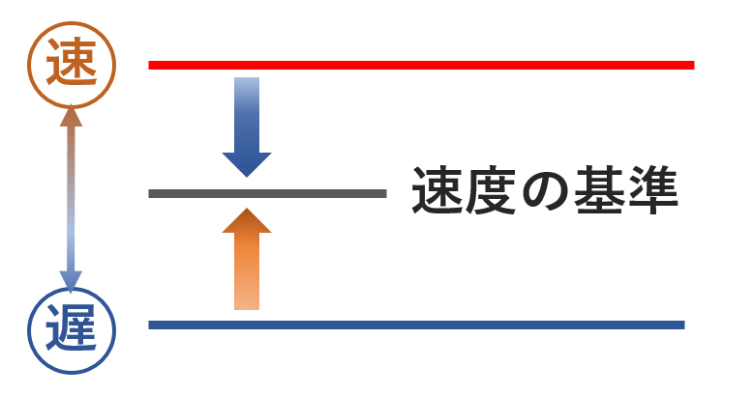
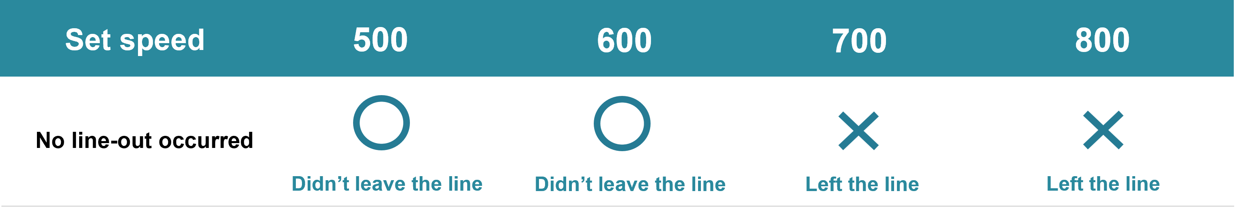
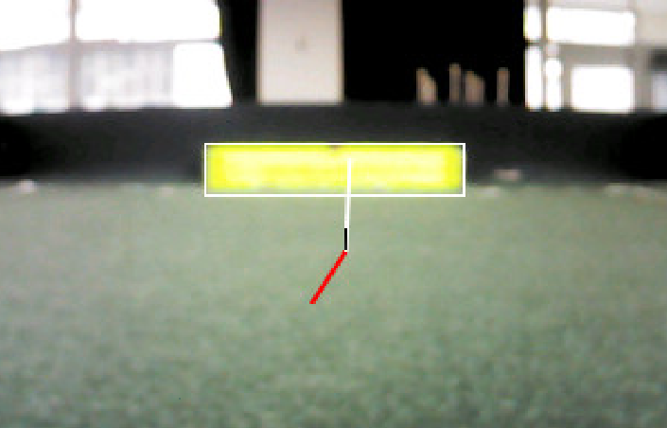
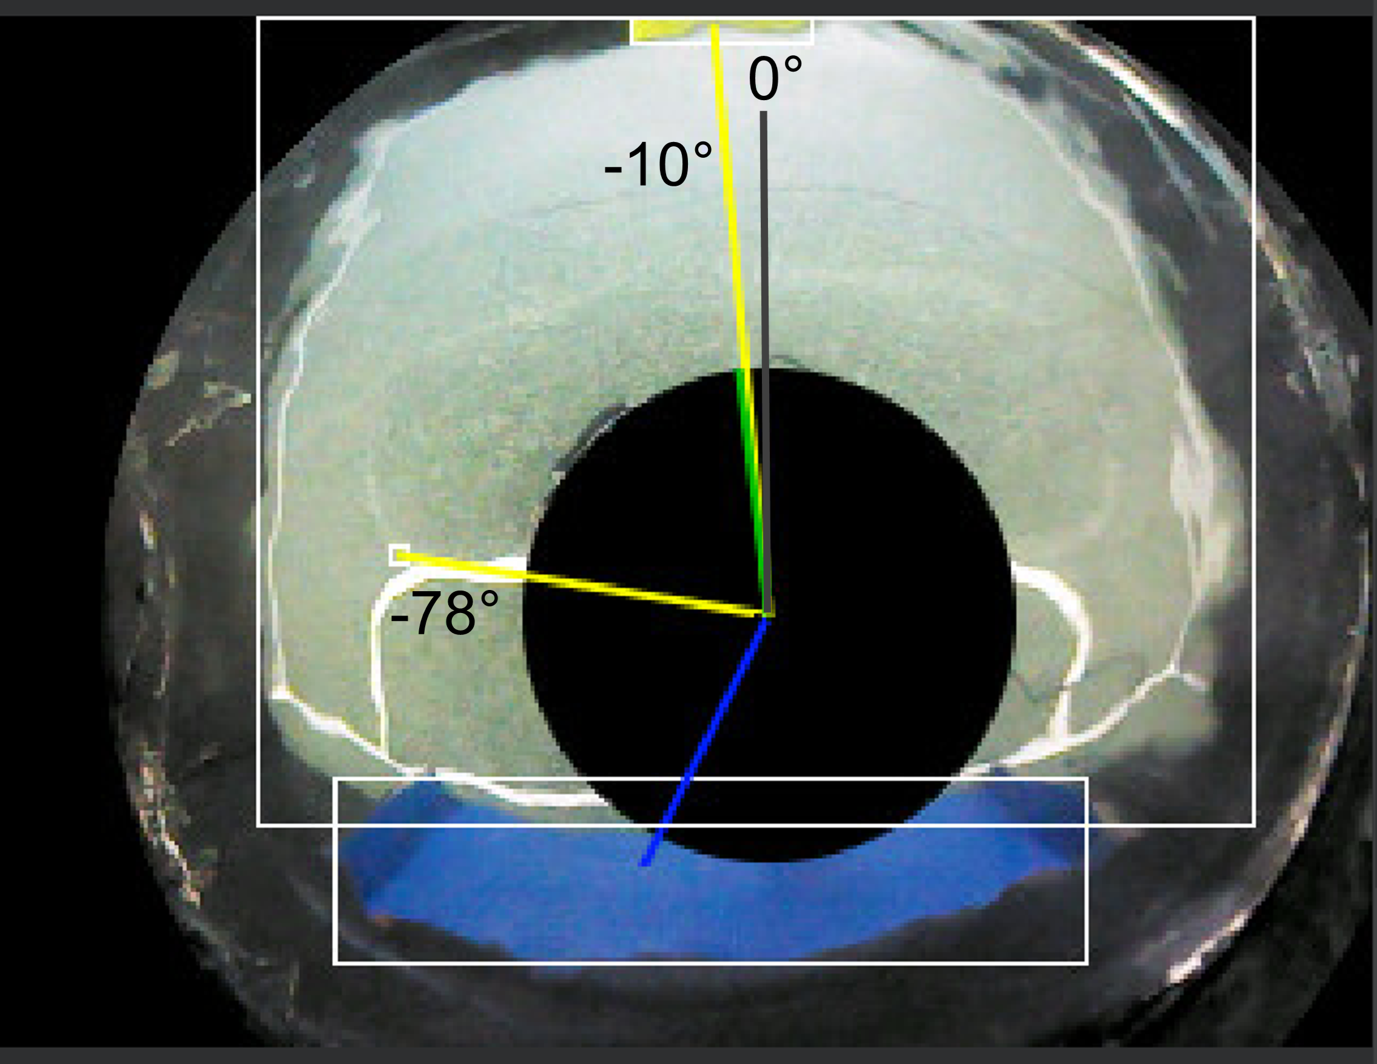
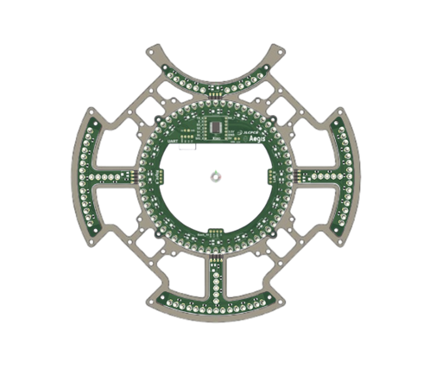
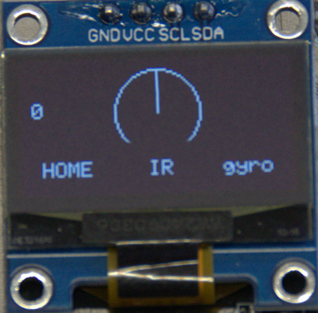
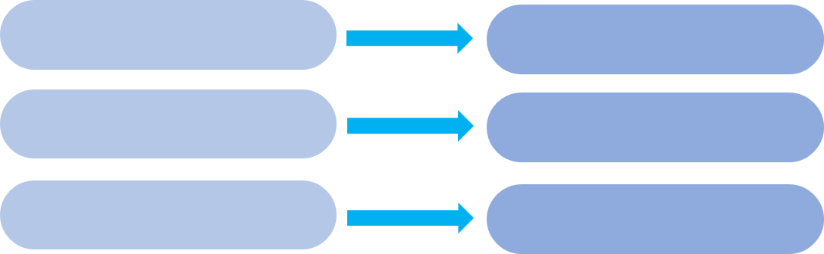
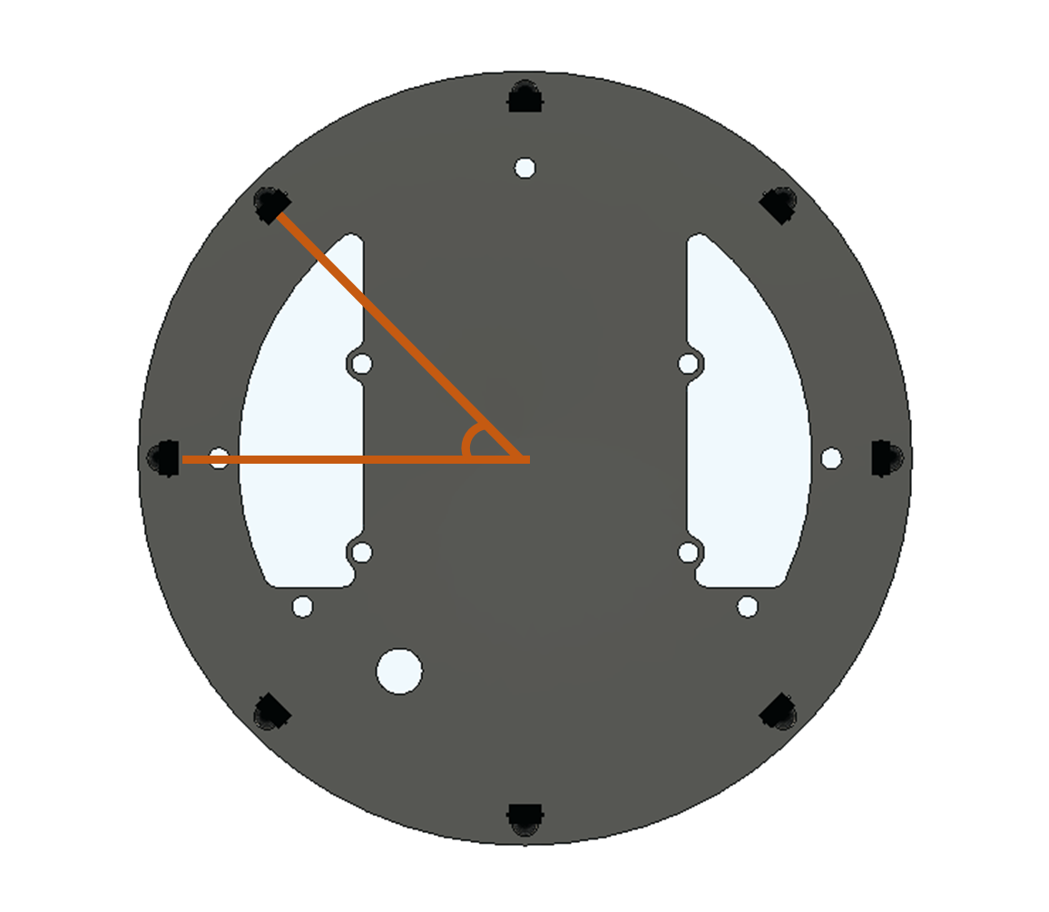
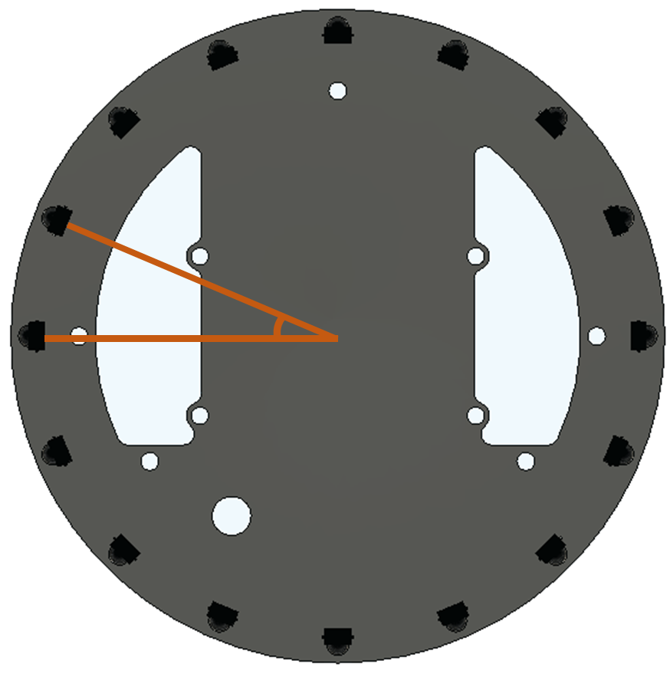
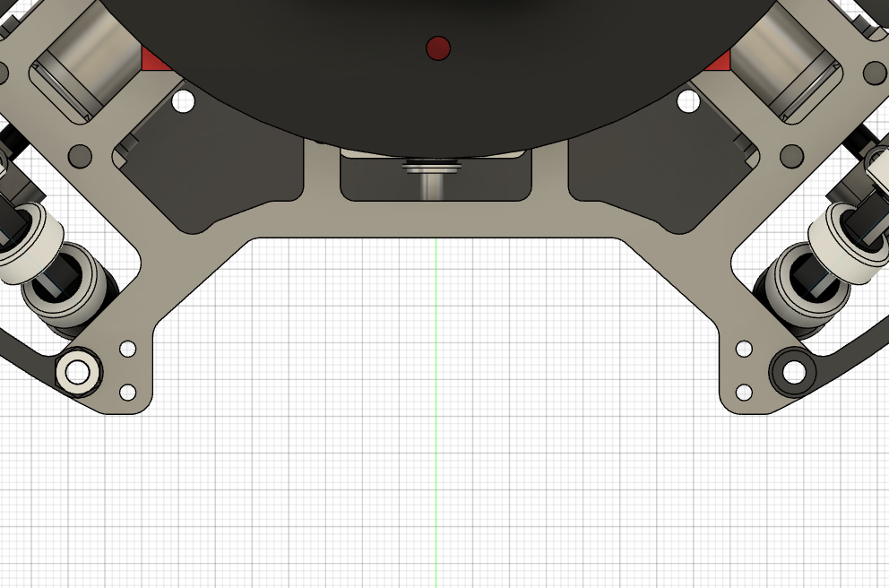
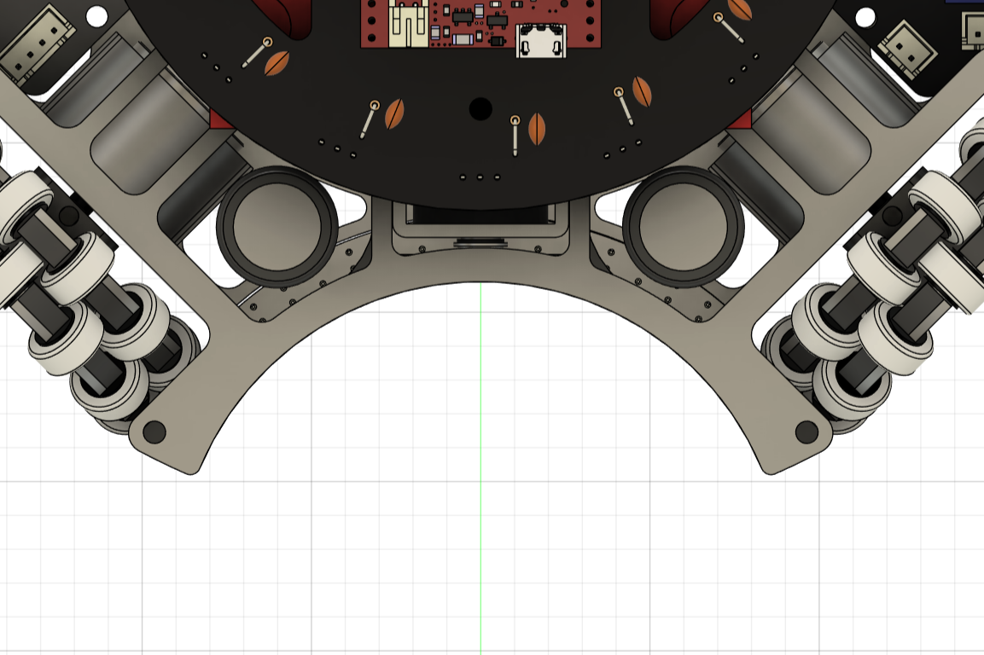
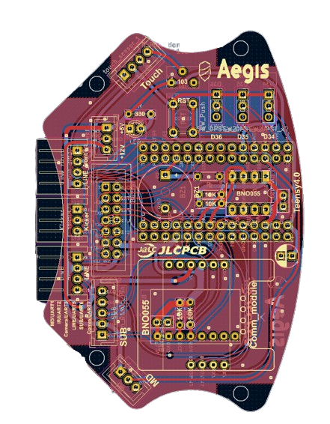
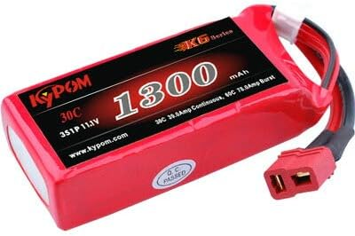
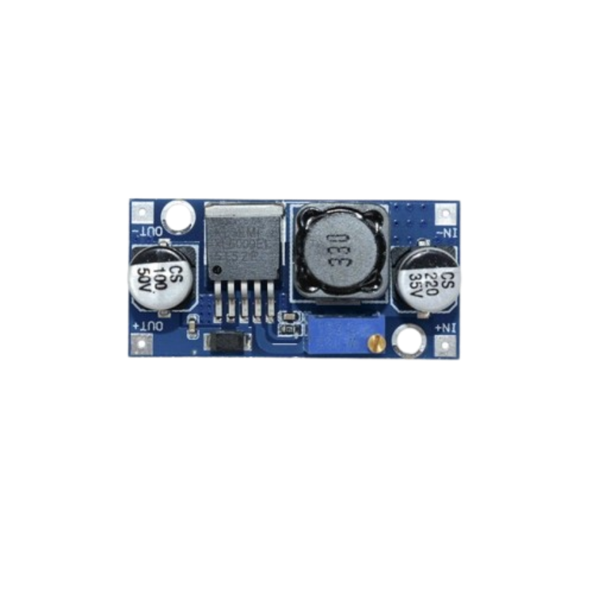
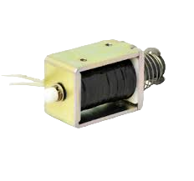
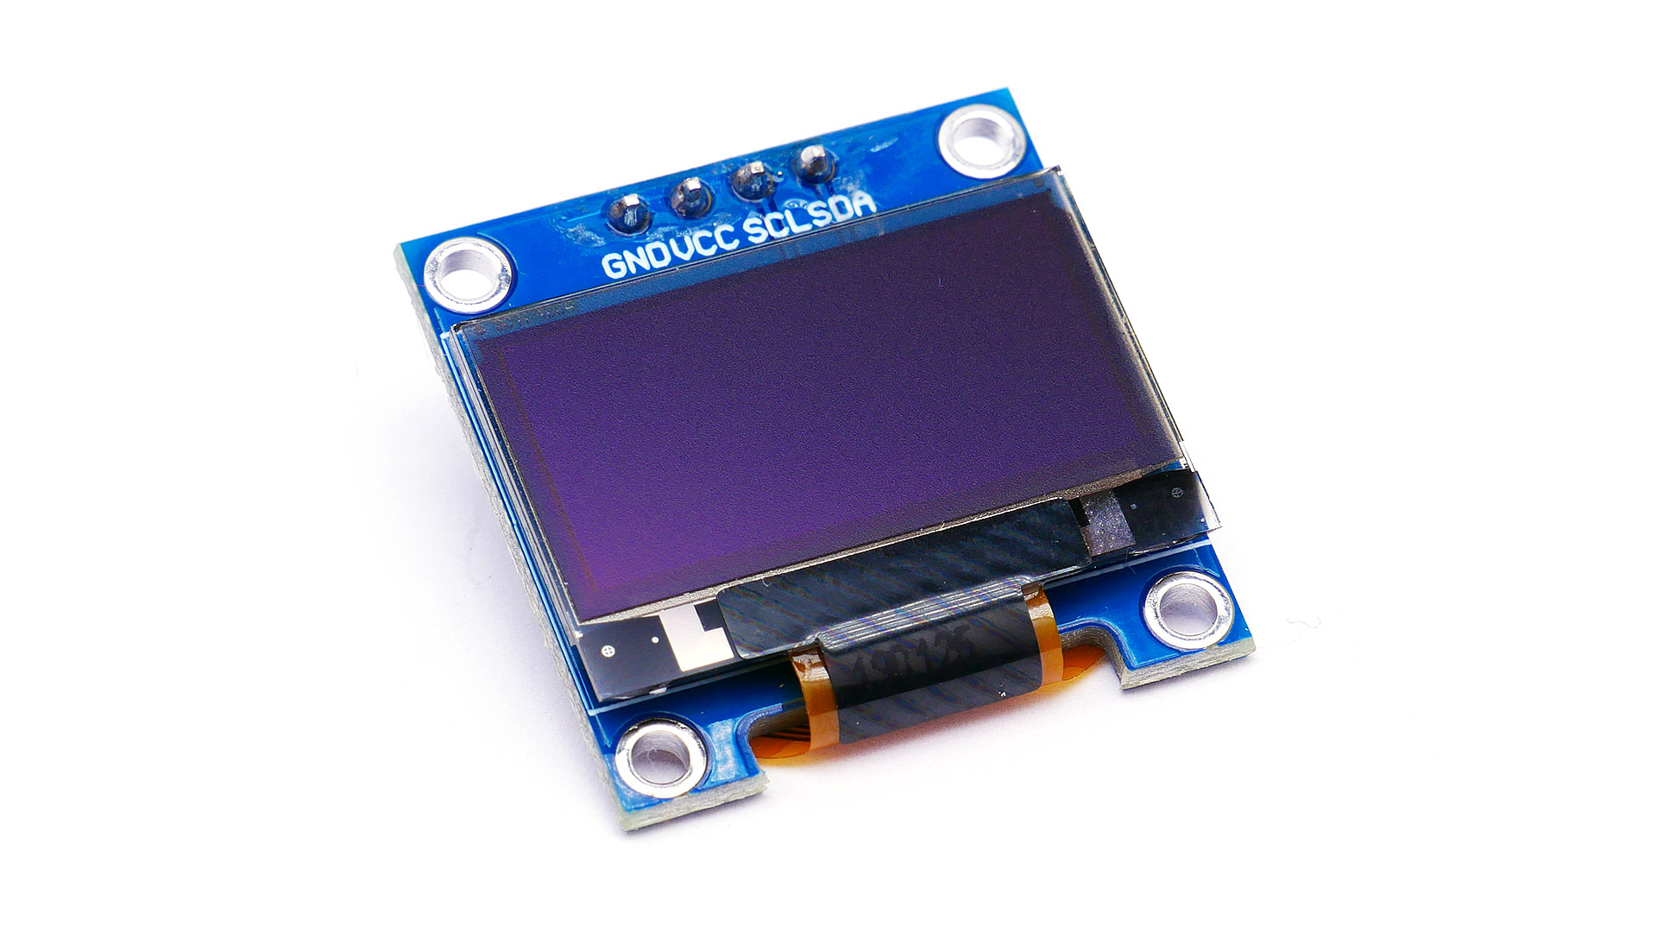
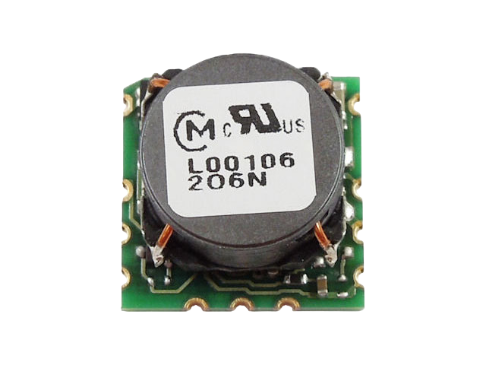
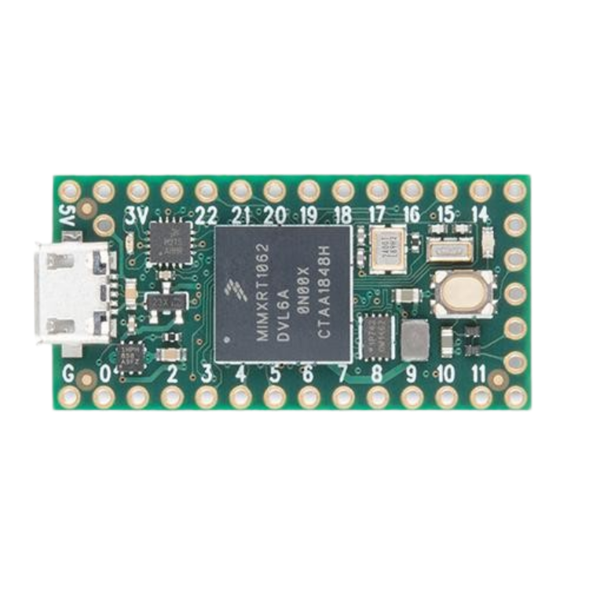
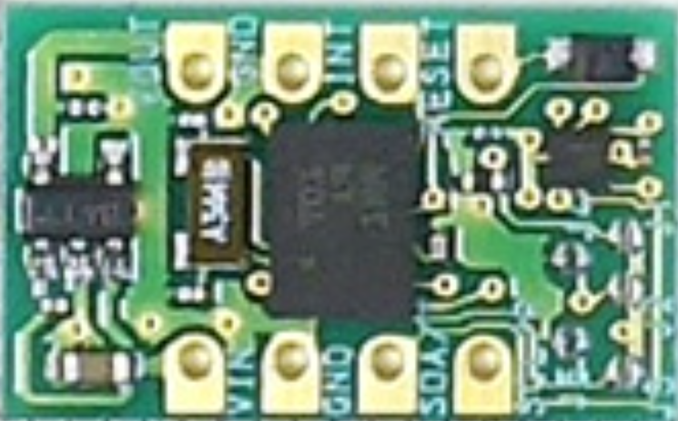
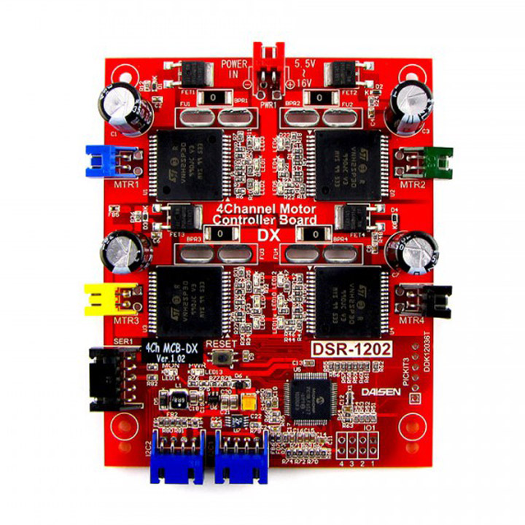
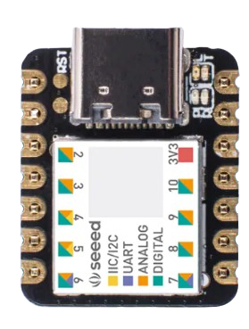
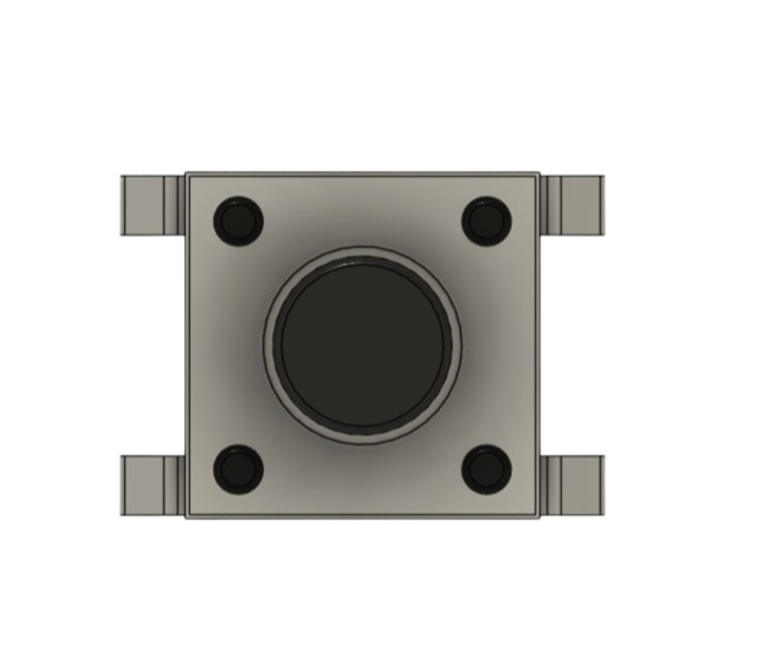
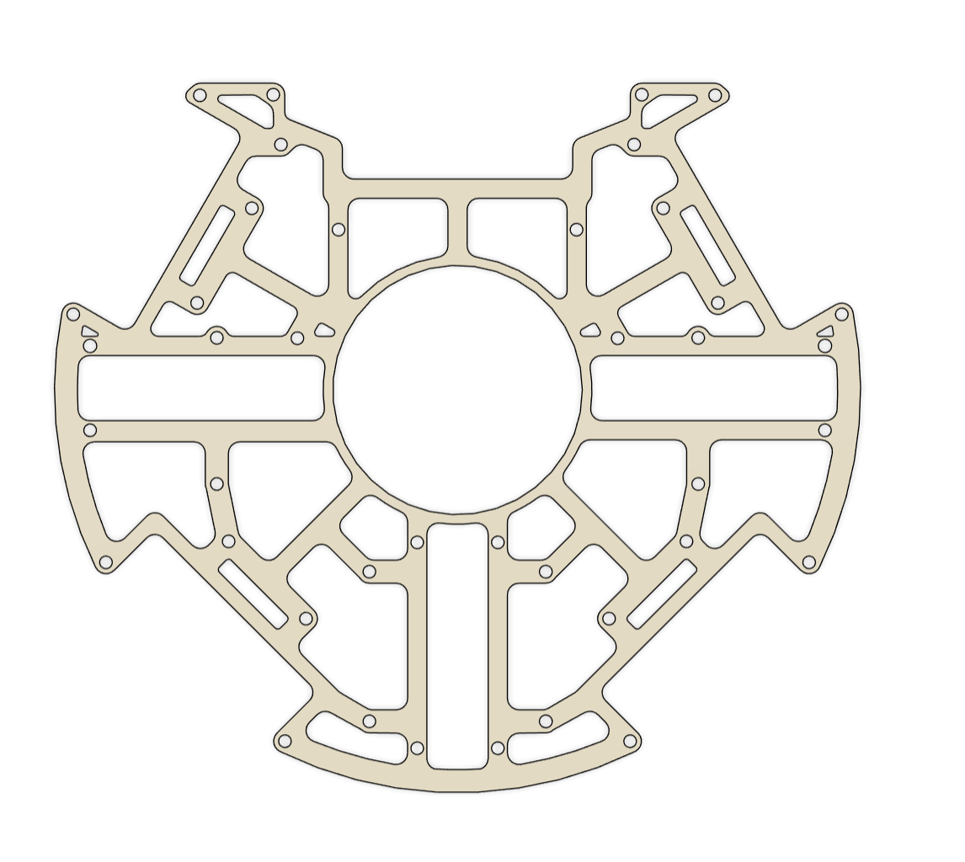
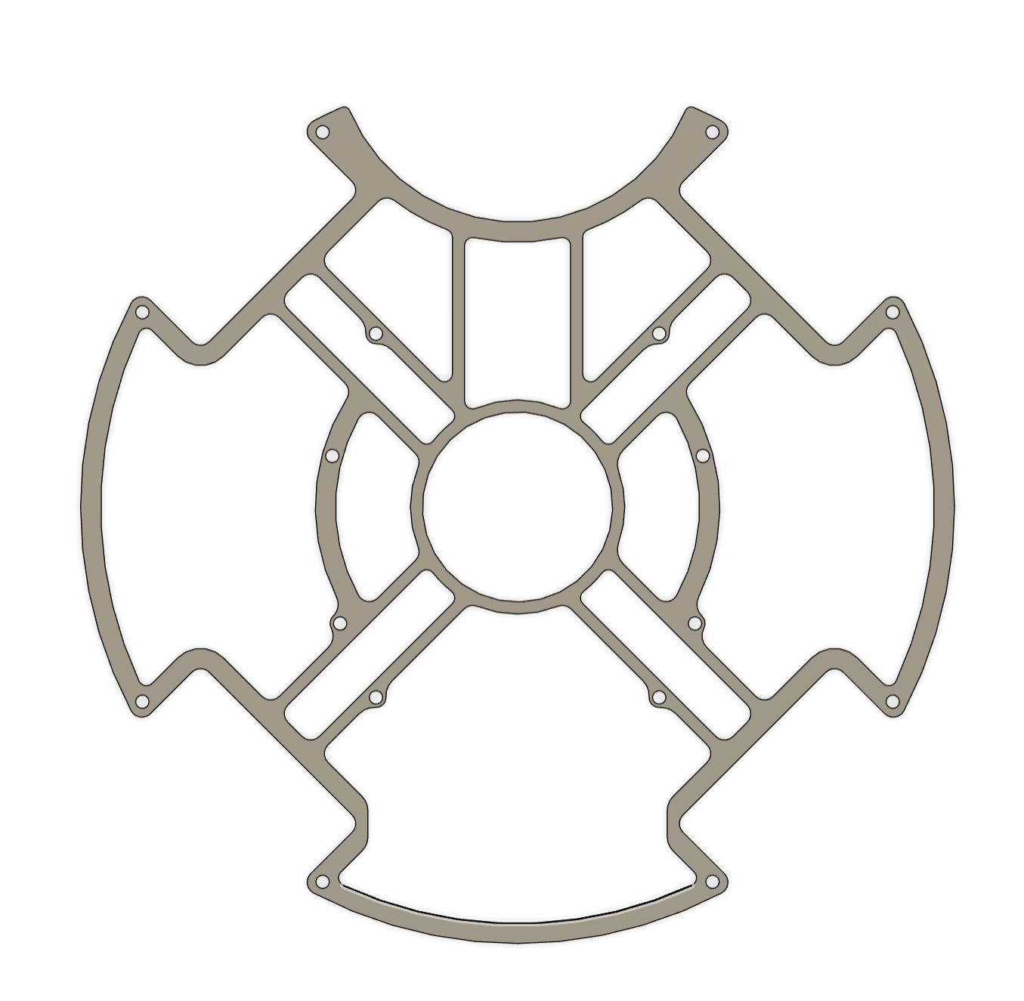
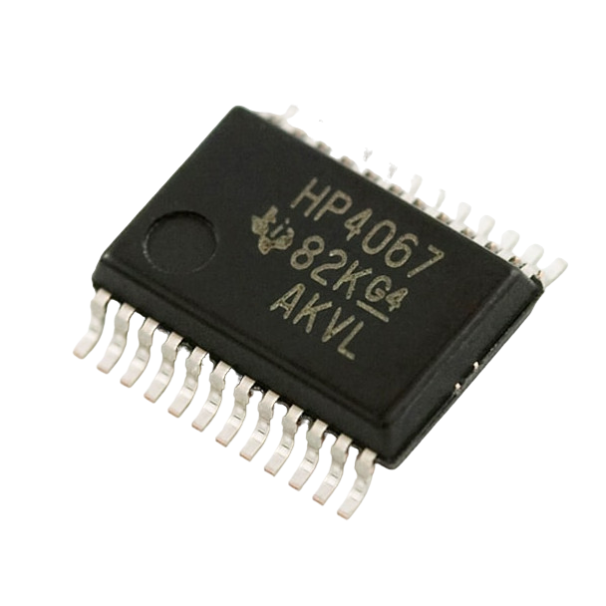
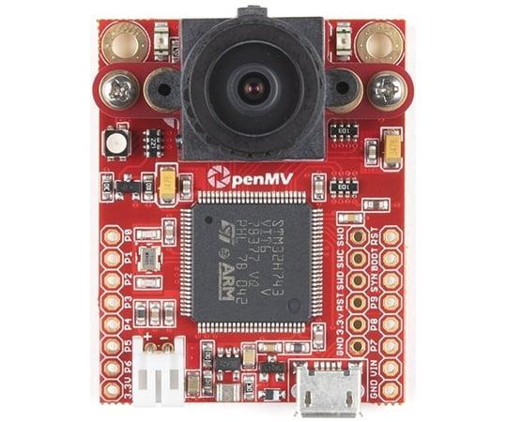
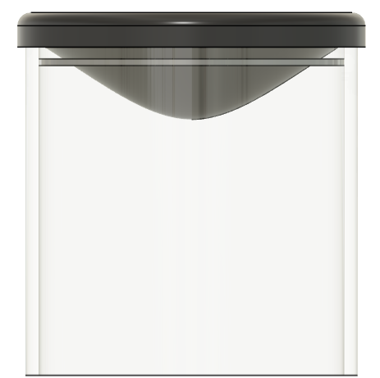
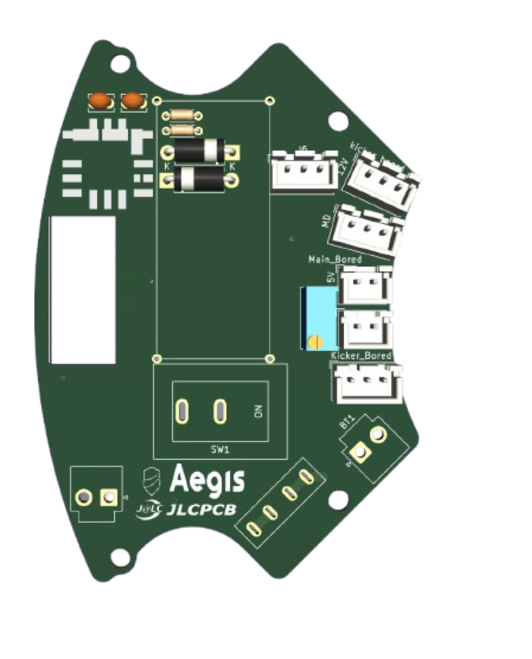
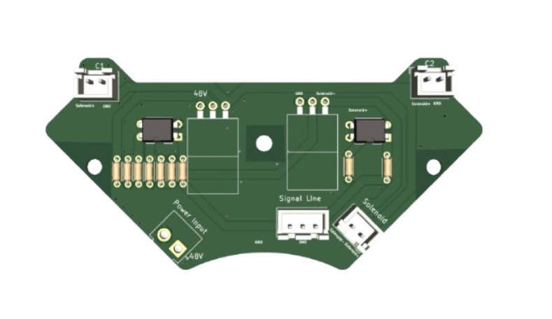
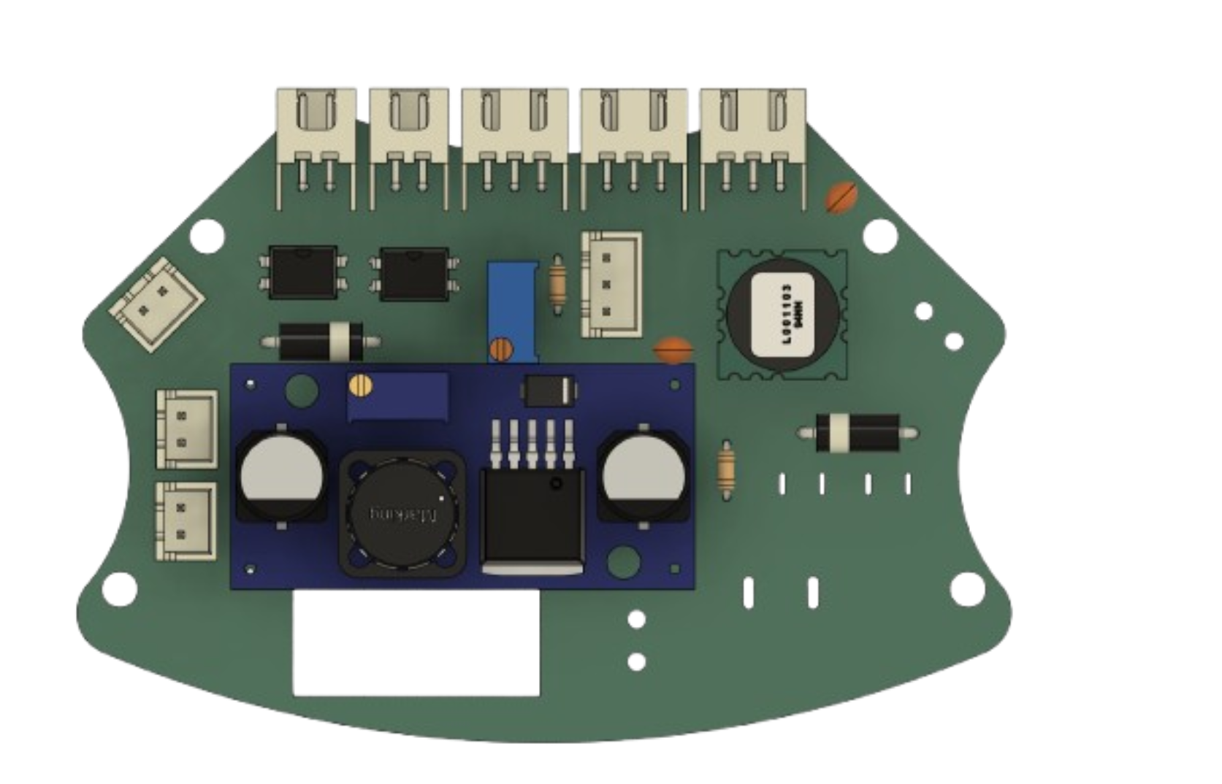
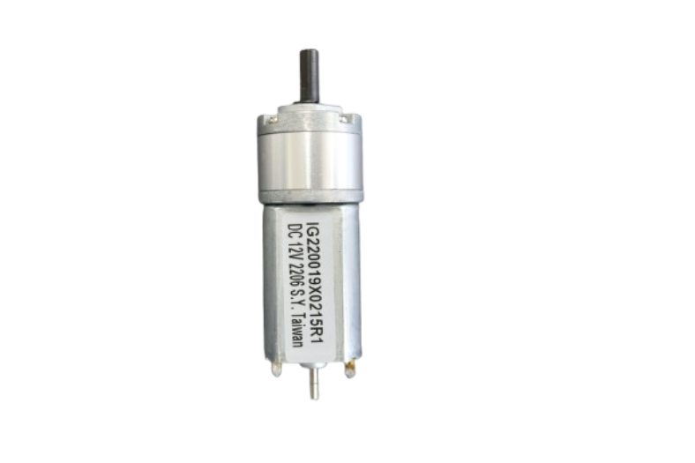
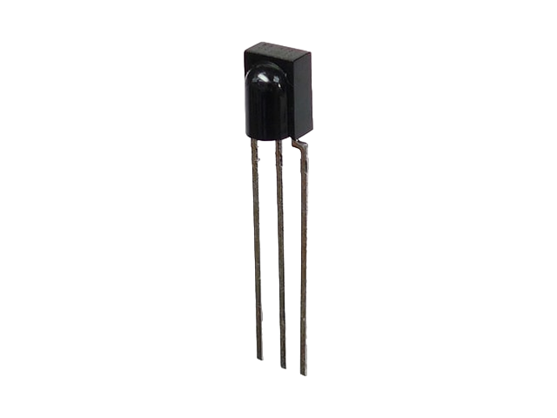





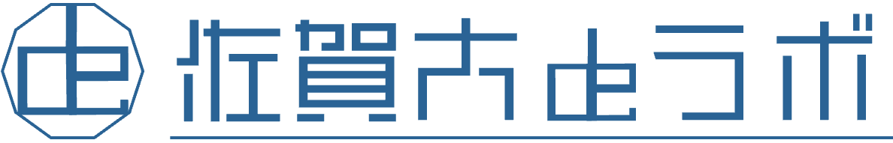



Team Member
Abstract
Software
We are “Munako Aegis,” a team of four Japanese high school students competing in the Lightweight League.
We began our activities in the 2023 season and have been steadily improving our skills through daily, dedicated work on our robot.
When we first started, none of us had any specialized skills. However, we tackled mechanical design, programming, and circuit design every day, gaining knowledge and experience through trial and error.
In our first year, we placed first in the preliminary competition and qualified for the Japan Open. However, we finished a disappointing 31st out of 64 teams in the main event.
Nevertheless, we didn't give up and kept working hard. This year, we won first place at the Japan Open. We also won the Best Presentation Award.
We primarily use Autodesk Fusion for mechanical design and KiCad for circuit design. For fabrication, we utilize 3D printers and CNC milling machines to develop robots efficiently and with high precision.
We write programs in Visual Studio Code, using C++ for the microcontroller and Micro Python for camera control, developed with the Open MV IDE.
Our robot uses duralumin for its body to combine light weight with high durability. We made exterior components, such as the battery box and side covers, ourselves using a 3D printer, allowing for design flexibility. For the circuit board, we asked our sponsor, JLCPCB, to fabricate it with high precision to achieve a stable circuit configuration.
The camera system uses an Omnidirectional Mirror, which we made ourselves by heat-pressing vinyl chloride. This allows a single camera to provide a 360-degree field of view while significantly reducing costs.
In addition, a kicker mechanism is installed using a solenoid provided by TAKAHA.
To address the “line-out” issue that many teams have struggled with in recent years, we incorporated speed control.
The robot measures its speed in real time as it moves and runs at the optimum speed according to its court position to prevent line-outs at the fastest possible speed.
In addition, we use a double-structured omni wheel design. The double structure increases the ground contact area with the floor and improves braking ability.
Red LEDs are used for the line sensor to improve response speed and accuracy. These innovations strengthen the line area.
For ball detection, we use a multiplexer to handle multiple inputs despite a limited number of pins, and we stabilize noisy values using moving average processing. In addition, an LCD monitor allows the user to check various values in real time without connecting to a PC.
In preparation for the world championships, we reviewed our robot’s design. The shape of the robot, which used to differ between the attacker and the goalkeeper, is now unified. By adopting two identical robots that combine the advantages of both roles, it is now possible to switch roles immediately during a match. Furthermore, all sensors and circuit boards are also standardized, resulting in improved parts management and even higher compatibility. You can follow our activities on X (formerly Twitter). We also publish all our data on GitHub.
Koki Suehiro
Team GitHub
Goalkeeper Program Manager
Team Name
Region
Yuta Kurisaki
Munako Aegis
JAPAN
Hardware
Attacker Program Manager
Our School
League
Team X
Umi Fujita
Munakata High School
Soccer LWL
Aircraft and Circuit Design Manager
Maiki Kimura
Circuit Design, Media Manager
Team Activities
Data / Results / Discussion
First year (first half)
First year (second half)
Second year (first half)
For the World Championship
Ⅾaily accumulation and planning are important
Second year (second half)
Tool
Speed control that leads to improved line control
Our team has been participating in the RoboCup Soccer Lightweight League since last season, making this our second year together. The team consists of four members — three of whom have been involved in robot competitions since high school, and one since junior high school. Despite being a relatively new team, we have set a major goal of "winning the world championship," and we’ve been working hard every day to build our robots and improve our technical skills. Given our limited time, we established a clear activity policy to ensure that every team member could grow steadily. In this presentation, we would like to introduce the policies we followed and how we advanced our activities based on them.
世界大会へ
Our team mainly uses the following software.
The motors we used on the robot last season
were 6-volt motors, which limited its speed and performance.
So we decided to look for faster and more efficient motors.
While keeping costs as low as possible, we chose 12-volt motors.
As a result, we came up with the following motor options.
・ DC geared motor 12V 1:19（DIGILENT IG22 1/19）
（ about 19 dollars ）June 2024
This motor had the performance we were looking for and
we thought it was a good choice. However, while this motor
increased the speed, it caused more out of bounds.
So, even if the robot is fast, it's meaningless if it goes out of bounds.
In the past, the motor speed was reduced to prevent out of bounds,
but there was a problem with the motor continuing to accelerate as it was. To solve this problem, we decided to use the BNO055 to measure the robot‘s speed. This allows us to reduce its speed near the boundary lines to prevent out-of-bounds, while allowing it to reach maximum speed at the center of the court.
Experimental environment
For the Verification 1 and Verification 2 experiments, we ran the robot from one end of the court to the other and used a recording timer to measure the distance traveled every 0.1 second. Based on these measurements, we calculated the average speed for each 0.1-second interval and created a graph showing how the speed changed over time. （See Photos 1 and 2）
「 Speed control 」
determine the set speed. If the measured speed is
below the set speed, increase the motor power.
Conversely, if the speed exceeds the set speed,
decrease the motor power.
This method is called "speed control."（See Figure 1）
We conducted the following verification to evaluate whether
this method is effective in preventing out of bounds.
Verification 1:
Exploring the difference between speed control and no control. To verify that the speed control was functioning correctly, we conducted experiments both with and without speed control.
Next, we compared the relationship between velocity (v: cm/s) and time (t: seconds) using graphs.
Result：
The graph shows that the speed is constant at 80 cm/s with speed control compared to without.
Verification 2:
Comparison of Deceleration Characteristics With and Without Speed Control.
The graph compares the relationship between velocity (v: cm/s) and time (t: seconds) in two cases.
In the first case, the robot was accelerated to a set speed using speed control, and then decelerated by reducing that set speed. In the second case, the robot was operated without speed control at a fixed PWM value for a certain time, and then decelerated by reducing the PWM value.
Result：
The graph shows a case where the final speeds after deceleration are approximately equal with and without speed control. In this example, the time required to decelerate to the set speed is shorter with speed control than without it, even though the initial speed was higher with speed control. This indicates that speed control is more effective for deceleration. (See Graph 2)
Verification 3:
Find the maximum value of the speed that is not out of bounds
The goal was to find the maximum speed at which the robot could stop without going out of bounds and hitting a wall when stepping on the line. We created a program to brake when stepping on the line, varied the set speed, and recorded the maximum speed that did not go out of bounds.
The results show that a set speed of 600 is the maximum optimal speed at which the robot can stop without going out of bounds. Therefore, this speed was set as the maximum speed when near the line. In other areas , we decided to use speed control with no upper speed limit.
(See Table 1)
For position estimation, a camera is used to estimate the position of the robot based on the direction of the center of the court.
Conclusion：
From Verification 1, it was observed that without speed control, the robot’s speed continues to increase, whereas with speed control, the speed eventually stabilizes.
From Verification 2, it was shown that the motor with speed control decelerates more quickly than the one without it.
From Verification 3, the maximum speed at which the robot can stop without going out of bounds was identified. Previously, this speed had been manually adjusted through trial and error.
2年目（後半）
Design
・KiCad
Used for circuit fabrication
・Autodesk Fusion
Used for designing
the robot’s frame and components
Each team member built their own robot, deepening their understanding of its structure and mechanisms.
Through the process of building robots,
we identified our own strengths and weaknesses and assigned team roles accordingly.
Reflecting on our experience at the Japan Open, we discussed the mechanisms we wanted to implement, examined the necessary technologies, created a plan, and clarified each step to steadily improve our technical skills.
Based on our past match experiences, we discussed additional mechanisms and strategies we wanted to implement, and as a team, we talked about what preparations were necessary for the upcoming competition.
Based on our experience at the Japan Open, we discussed what we need to do to adapt to the environment of the World Championship.
Goal
2年目（前半）
Program
Effect of Speed Control on Deceleration
▷Gragh2
winning the World Championship
１年目（後半）
・ Visual Studio
Used for programming (except for the camera) with C++
・ OpenMV IDE
Used for programming the camera with Python
(v: cm/s)
In order to enhance our technical skills, we have dedicated an enormous amount of time and made continuous, extraordinary efforts. On weekends, we work from 10 a.m. to 5 p.m., and on weekdays, we usually continue activities from 4 p.m. to 7 p.m. after school. The graph on the right shows the cumulative number of hours we’ve spent on robot development, broken down by month. The vertical axis represents the time spent working on the robot (in minutes), and the horizontal axis represents the progression of dates. This graph is a record of our relentless efforts to aim for the world stage, despite having limited time. Our total activity time amounts to approximately 180,000 minutes — or about 3,140 hours. This massive amount of time is proof of our wholehearted belief that “small efforts every day will eventually lead to great achievements. ”Through our journey, we have not only built robots — we’ve also developed the very ability to persevere as a team. Because we experienced both failure and success with our own hands, we’ve come to truly understand that continued effort leads to growth and results — and ultimately to building stronger robots.
１年目（前半）
Management
・ Discord
Used for sharing information among team members
・ GitHub
Used for data storage
Method / Production / Design
(t: seconds)
Robot 1,2
01 Vision System
The Open MV H7 is limited to a viewing angle of about 70 degrees when used as a stand-alone camera, which is not enough for the robot to simultaneously grasp all directions of its surroundings. Therefore, we combined the Open MV H7 with an Omnidirectional Mirror to create a system that allows the robot to acquire 360-degree omnidirectional images. The Omnidirectional Mirror is made of polyvinyl chloride (PVC),which is softened by heating and then pressed (heat-pressed) onto a hyperboloid surface made with a 3D printer to match the ideal shape we designed on a computer. This can then be used to reflect the robot’s surroundings back to the camera, making it possible to acquire information from all directions with a single camera.
Omnidirectional Mirror
06 Motor & Omni Wheel
This season's robot features several improvements in the drive system. First, the robot is equipped with four DIGILENT IG22 1/19 high-precision gear motors, which provide higher torque and more stable power performance than . These motors are controlled by a 4CH motor controller (DSR1202). The structure of the omni wheel has also been improved to enhance the stability and controllability of the robot. By changing from a conventional one-layer structure to a two-layer structure, the grip has been improved, enabling the robot to maintain stable traveling performance even in situations where complex movements and fine control are required. In addition, our omni wheel has a larger diameter than the previous one, which allowed us to increase its speed. The inner part of the omni wheel is made of 3D printed parts, and the outer part is made of duralumin. This made it easier to mass produce and less prone to breakage.
４
1
2
３
▷Photo１ The experiment scene
▷Photo２ The experiment scene
Fast
Comparison of Speeds Without Going Out of Bounds
9
6
11.1V
one-layer
structure
two-layer
structure
Set speed
stand-alone camera
Omnidirectional camera
07 Line Sensor
This season‘s robot is equipped with a more advanced line detection system that combines a circular line sensor with the outer line sensors. First, the line sensor is equipped with more LEDs than before. This allows the robot to accurately detect white lines over a wider area, in the outer areas. Seeduino XIAO is used to read the sensors, but initially the number of sensors that could be installed was limited due to the limited number of ports. The number of sensors could be increased by introducing a multiplexer. This sensor system has been particularly effective on the goalkeeper robot. This system makes it possible to track the white line
precisely and maintain stable operation at all times during play.
The circular line sensor plays an important role in determining the direction of
course. By reliably detecting them, the robot can always maintain the correct
trajectory. Meanwhile the outer line sensors serve as a reference to correct
the robot so that it does not deviate from the course. Furthermore, the robot
used in the national competition had several occasions where it went out of
the white line on the field. Therefore, by reviewing the placement of
the line sensors, we succeeded in reducing the “unresponsive blind spots” that
existed at the bottom of the robot. This has further improved the overall
line detection accuracy, as well as the consistency and accuracy of operation.
Slow
▷Fig2
５
▷Fig1 Mechanism of speed control
This composition allows the robot to constantly monitor its surroundings with a single camera, and to acquire and process
information such as the position of the goal and the direction of the center of the court in real time. With fewer sensors than before,
this enables a wider and more efficient recognition of the environment, contributing greatly to posture control that let the
robot always face the direction of the goal and also line control. These programs use Python.
Effect of Speed Control on Velocity Stability
8
02 Debug System
By equipping the robot with an O-LED Display, data from the
sensors can now be known in real time. This allows the user to quickly grasp the state of the robot and its surroundings, making it possible to make immediate changes to tactics and respond to problems more quickly and
flexibly. In the past, the robot had to be stopped and connected to a PC to
check sensor data. The O-LED Display has greatly reduced the time and effort
required to do this. This is a big advantage, especially in the limited time available for matches, where on-site decisions and response speed are
required. The OLED-Display can also be used for on-site debugging,
contributing to improved development efficiency.
(v: cm/s)
▷Gragh1
7
Actual screen
Robot’s Concept This season, we focused on the concept of “a strong robot that moves accurately” and made improvements to the sensors, structural design, and drive performance. For visual sensors, we combined an Open MV camera with an omni-directional mirror to enable the robot to recognize the entire court with only one camera. For ball detection, a system consists of 16 balls sensors placed in a circle, is used to provide more accurate angle detection. In particular, the ball sensor system eliminates the pin count limitation of microcontrollers by using a multiplexer. Significant enhancements have also been made to offensive performance. A newly designed kicker device and a capture zone that fits the shape of the ball, made by a 3D printer, reduces the number of kick failure. This dramatically improves the stability and power of the shot, and enables stable forward delivery of the ball. As a result, we managed to improve its performance as a "robot that can surely score goals”. The DIGILENT IG22 1/19 motor is used for the drive system to achieve a good balance of controllability and power of the robot. Furthermore, the two-layer omni wheel, which has evolved from a single-layer structure, provides smooth movement. We also focused on making it easy to repair and debug the robot during the game. The on-board OLED Display enables us to check the real-time sensor data for quick troubleshooting and adjustments, eliminating the need for a PC connection and greatly improving the maintenance performance. As a main microcontroller, we chosen Teensy 4.0, ensuring high-speed communication and rich I/O expandability. In addition, we have placed emphasis on maintainability and stability through the use of flat cables, LEDs, and wiring design that takes noise suppression into consideration. Also, we used to manufacture the attacker and goalkeeper robot separately. But from this time, both robots share all sensors and circuit boards, simplifying parts management and achieving a high degree of interchangeability.
As a result of this test, the following is now possible
New line sensor layout
Verification1
Speed instability
Speed stability
03 IR Board
Until now, we have only been able to mount up to eight ball sensors on the Seeduino XIAO due to pin count limitations. This configuration enabled angle detection, but the wide spacing between sensors resulted in low detection accuracy and error. We introduced a multiplexer to solve this problem. This technical innovation made it possible to deploy 16 ball sensors. The increase in the number of sensors has narrowed the distance between each sensor, allowing angles to be detected with higher accuracy.
08 Ball Capture Zone & solenoid
We have one new kicker (CB1037) on our robot this season. In order to maximize the performance of this kicker device , we devised a way to fully convey the power of the kicker device to the ball. Of particular importance was to ensure that the ball was well caught when kicked. Previously, even if the ball was caught, it did not mesh well with the kicker device mechanism and could not be shot. To solve this problem, we utilized a 3D printer to create a “ball-capture zone” that fits the shape of the ball perfectly. This enabled the ball to be reliably captured. This design change was aimed at greatly increasing the success rate of the kick, solving the previous capture force problem and significantly improving the accuracy of the robot. By optimizing the shape of the ball-capturing zone, the force of the kick was transmitted more firmly to the ball, enabling the ball to fly at a more accurate angle, giving the robot an advantage in close matches against its opponents at national tournaments.
Verification2
Slow deceleration
Before introduction
Of multiplexer
After introduction
Of multiplexer
(t: seconds)
Quick deceleration
Verification3
Unclear maximum speed
Clear maximum speed
Smoothing Sensor Readings Using Moving Average
Evaluation of Optimal LED Color for Line Sensors
04 Main Board
The main board uses Teensy 4.0 and has7 UARTs, 40 digital pins, 14 analog pins, and abundant pin counts. The main board design uses flat cables to reduce」
the number of cables. In addition, curves are used in the wiring design to reduce the effects of noise, which enhances the stability of the signal and the overall operational reliability of the robot. An LED is provided on the board to visually check the energized state, preventing human error. By clearly indicating the connection points, not only does it prevent wiring errors, but it also contributes to more efficient programming workflow. Our robots are designed to be equipped with two types of gyro-sensors. This is so that if one sensor fails, we can instantly switch to the other by replacing the program. This backup design ensures that stable operation is maintained even if a sensor malfunctions during competitions.
There were some fluctuations in the analog values from the ball sensor. To reduce this, we applied
a moving average filter to the sensor readings. We rolled the ball away from the sensor and observed the changes in the readings. We analyzed how the variation changed with different numbers of moving average samples and finally chose 10 samples. The graph below compares the results with and without the moving average.
Result：
The graph shows that applying a moving average filter makes the sensor readings smoother. Based on this result, we also applied the moving average to the analog values of the line sensor,
not just the ball sensor.
Our line sensors have been using white LEDs until now, We decided to experiment with the question of whether white LEDs are really suitable. We are using full-color LEDs in the experiment that can change the color and brightness of the light. We made a graph and a table of the data when the robot passed a white line using red, green, and blue light compared to the white light we had used before.
Robot’s Structure
Wired to curve
Old capture zone
Effect of a Moving Average Filter
▷Gragh3
Response Values by Color
Max-Min Difference for Each Color
Battery
:Kypon
1300mAh/ 3s /11.1V
Unit price:$13.84
Kicker System
:XL6009
Unit price:$0.75
48V
Solenoid
:CB1037 x 1
Unit price:$19.6
Debug System
New capture zone
Analog value
11.1V
11.1V
Gyro Sensor
:AE-BNO055-BO
Unit price:$3.29
09 Frame
The frames that form the foundation of our robots are fabricated using duralumin (an aluminum alloy). Duralumin is a strong and extremely lightweight metal that is also used in aircrafts. By taking advantage of its characteristics, we have been able to create a design that is both sturdy and light. We are also thoroughly committed to reducing the weight of our frames. We achieved a structure that maintains strength while reducing weight by cutting out unnecessary parts while maintaining the necessary strength . Fusion 360 was used to design the frame, and actual cutting was done on a CNC machine in our club. This allowed us to repeat the design and prototyping process in a short cycle, resulting in an optimal frame structure. After a year of trial and error since last season, we finally arrived at this frame.
11.1V
Voltage
Conversion Circuit
Using IC :
OKL-T/6-W12N-C
11.1V to 5.0V
Unit price:$6.03
5.0V
Main Controller
:Teensy 4.0
Unit price:$42.41
I2C
O-LED Display
：SSD1306
Unit price$3.97
05 Power Board & Kicker Board
Previously, the power board and kicker board were manufactured separately, but from this season we have integrated them on one board to save space and simplify wiring. This has made the robot's internal structure more compact and greatly improved the efficiency of assembly and parts replacement. The power supply board uses a DC-DC converter and is designed to provide stable power to each module. This minimizes voltage fluctuations during operation and improves overall system stability. The kicker circuit also incorporates a voltage booster circuit, which is designed to provide a stable output of high voltage (48V).
I2C
UART
UART
UART
UART
Motor Driver
DAISEN DSR-1202
IC:VNH2SP30 x 4
・0.3V ~ 16.0V
・15~30A
Unit price:$135.69
Sub
Controller
:Seeeduino XIAO
Unit price:$6.51
Sub
Controller
:Seeeduino XIAO
Unit price:$6.51
UART
Tactile Switch x 3
Unit price:$0.1
Number of readings
▷Gragh4
▷Gragh5
Digital
Digital
Vision System
Looking at Figure 1, it’s easy to assume that white light is advantageous because the response values are high. However, it’s also evident that the values when there is no response are higher compared to those of other colors.
For line sensors, a greater difference between the minimum and maximum values is more advantageous.
Comparing the differences in Figure 2, red and blue show a larger range than the other two colors. However, blue is a prohibited color and cannot be used.
Therefore, it can be concluded that the most suitable light source for the sensor is red.
11.1V
Multiplexer
Unit price:$1.34
Multiplexer
Unit price:$1.34
X 4
Analog
Analog
Motor
:DIGILENTIG22 1/19
Unit price$14.8
Ball sensors
:TSSP58038× 16
Unit price:$1.03
Line Sensors
:NJI7502
Unit price:$0.34
Camera
:OpenMV H7
Unit price:$80
Omnidirectional Mirror
Last season's frame
This season's frame
Sponsor
今田 耕司様

Slide 2
Team Member
Abstract
Software
We are “Munako Aegis,” a team of four Japanese high school students competing in the Lightweight League.
We began our activities in the 2023 season and have been steadily improving our skills through daily, dedicated work on our robot.
When we first started, none of us had any specialized skills. However, we tackled mechanical design, programming, and circuit design every day, gaining knowledge and experience through trial and error.
In our first year, we placed first in the preliminary competition and qualified for the Japan Open. However, we finished a disappointing 31st out of 64 teams in the main event.
Nevertheless, we didn't give up and kept working hard. This year, we won first place at the Japan Open. We also won the Best Presentation Award.
We primarily use Autodesk Fusion for mechanical design and KiCad for circuit design. For fabrication, we utilize 3D printers and CNC milling machines to develop robots efficiently and with high precision.
We write programs in Visual Studio Code, using C++ for the microcontroller and Micro Python for camera control, developed with the Open MV IDE.
Our robot uses duralumin for its body to combine light weight with high durability. We made exterior components, such as the battery box and side covers, ourselves using a 3D printer, allowing for design flexibility. For the circuit board, we asked our sponsor, JLCPCB, to fabricate it with high precision to achieve a stable circuit configuration.
The camera system uses an Omnidirectional Mirror, which we made ourselves by heat-pressing vinyl chloride. This allows a single camera to provide a 360-degree field of view while significantly reducing costs.
In addition, a kicker mechanism is installed using a solenoid provided by TAKAHA.
To address the “line-out” issue that many teams have struggled with in recent years, we incorporated speed control.
The robot measures its speed in real time as it moves and runs at the optimum speed according to its court position to prevent line-outs at the fastest possible speed.
In addition, we use a double-structured omni wheel design. The double structure increases the ground contact area with the floor and improves braking ability.
Red LEDs are used for the line sensor to improve response speed and accuracy. These innovations strengthen the line area.
For ball detection, we use a multiplexer to handle multiple inputs despite a limited number of pins, and we stabilize noisy values using moving average processing. In addition, an LCD monitor allows the user to check various values in real time without connecting to a PC.
In preparation for the world championships, we reviewed our robot’s design. The shape of the robot, which used to differ between the attacker and the goalkeeper, is now unified. By adopting two identical robots that combine the advantages of both roles, it is now possible to switch roles immediately during a match. Furthermore, all sensors and circuit boards are also standardized, resulting in improved parts management and even higher compatibility. You can follow our activities on X (formerly Twitter). We also publish all our data on GitHub.
Koki Suehiro
Team GitHub
Goalkeeper Program Manager
Team Name
Region
Yuta Kurisaki
Munako Aegis
JAPAN
Hardware
Attacker Program Manager
Our School
League
Team X
Umi Fujita
Munakata High School
Soccer LWL
Aircraft and Circuit Design Manager
Maiki Kimura
Circuit Design, Media Manager
Team Activities
Data / Results / Discussion
First year (first half)
First year (second half)
Second year (first half)
For the World Championship
Ⅾaily accumulation and planning are important
Second year (second half)
Tool
Speed control that leads to improved line control
Our team has been participating in the RoboCup Soccer Lightweight League since last season, making this our second year together. The team consists of four members — three of whom have been involved in robot competitions since high school, and one since junior high school. Despite being a relatively new team, we have set a major goal of "winning the world championship," and we’ve been working hard every day to build our robots and improve our technical skills. Given our limited time, we established a clear activity policy to ensure that every team member could grow steadily. In this presentation, we would like to introduce the policies we followed and how we advanced our activities based on them.
世界大会へ
Our team mainly uses the following software.
The motors we used on the robot last season
were 6-volt motors, which limited its speed and performance.
So we decided to look for faster and more efficient motors.
While keeping costs as low as possible, we chose 12-volt motors.
As a result, we came up with the following motor options.
・ DC geared motor 12V 1:19（DIGILENT IG22 1/19）
（ about 19 dollars ）June 2024
This motor had the performance we were looking for and
we thought it was a good choice. However, while this motor
increased the speed, it caused more out of bounds.
So, even if the robot is fast, it's meaningless if it goes out of bounds.
In the past, the motor speed was reduced to prevent out of bounds,
but there was a problem with the motor continuing to accelerate as it was. To solve this problem, we decided to use the BNO055 to measure the robot‘s speed. This allows us to reduce its speed near the boundary lines to prevent out-of-bounds, while allowing it to reach maximum speed at the center of the court.
Experimental environment
For the Verification 1 and Verification 2 experiments, we ran the robot from one end of the court to the other and used a recording timer to measure the distance traveled every 0.1 second. Based on these measurements, we calculated the average speed for each 0.1-second interval and created a graph showing how the speed changed over time. （See Photos 1 and 2）
「 Speed control 」
determine the set speed. If the measured speed is
below the set speed, increase the motor power.
Conversely, if the speed exceeds the set speed,
decrease the motor power.
This method is called "speed control."（See Figure 1）
We conducted the following verification to evaluate whether
this method is effective in preventing out of bounds.
Verification 1:
Exploring the difference between speed control and no control. To verify that the speed control was functioning correctly, we conducted experiments both with and without speed control.
Next, we compared the relationship between velocity (v: cm/s) and time (t: seconds) using graphs.
Result：
The graph shows that the speed is constant at 80 cm/s with speed control compared to without.
Verification 2:
Comparison of Deceleration Characteristics With and Without Speed Control.
The graph compares the relationship between velocity (v: cm/s) and time (t: seconds) in two cases.
In the first case, the robot was accelerated to a set speed using speed control, and then decelerated by reducing that set speed. In the second case, the robot was operated without speed control at a fixed PWM value for a certain time, and then decelerated by reducing the PWM value.
Result：
The graph shows a case where the final speeds after deceleration are approximately equal with and without speed control. In this example, the time required to decelerate to the set speed is shorter with speed control than without it, even though the initial speed was higher with speed control. This indicates that speed control is more effective for deceleration. (See Graph 2)
Verification 3:
Find the maximum value of the speed that is not out of bounds
The goal was to find the maximum speed at which the robot could stop without going out of bounds and hitting a wall when stepping on the line. We created a program to brake when stepping on the line, varied the set speed, and recorded the maximum speed that did not go out of bounds.
The results show that a set speed of 600 is the maximum optimal speed at which the robot can stop without going out of bounds. Therefore, this speed was set as the maximum speed when near the line. In other areas , we decided to use speed control with no upper speed limit.
(See Table 1)
For position estimation, a camera is used to estimate the position of the robot based on the direction of the center of the court.
Conclusion：
From Verification 1, it was observed that without speed control, the robot’s speed continues to increase, whereas with speed control, the speed eventually stabilizes.
From Verification 2, it was shown that the motor with speed control decelerates more quickly than the one without it.
From Verification 3, the maximum speed at which the robot can stop without going out of bounds was identified. Previously, this speed had been manually adjusted through trial and error.
2年目（後半）
Design
・KiCad
Used for circuit fabrication
・Autodesk Fusion
Used for designing
the robot’s frame and components
Each team member built their own robot, deepening their understanding of its structure and mechanisms.
Through the process of building robots,
we identified our own strengths and weaknesses and assigned team roles accordingly.
Reflecting on our experience at the Japan Open, we discussed the mechanisms we wanted to implement, examined the necessary technologies, created a plan, and clarified each step to steadily improve our technical skills.
Based on our past match experiences, we discussed additional mechanisms and strategies we wanted to implement, and as a team, we talked about what preparations were necessary for the upcoming competition.
Based on our experience at the Japan Open, we discussed what we need to do to adapt to the environment of the World Championship.
Goal
2年目（前半）
Program
Effect of Speed Control on Deceleration
▷Gragh2
winning the World Championship
１年目（後半）
・ Visual Studio
Used for programming (except for the camera) with C++
・ OpenMV IDE
Used for programming the camera with Python
(v: cm/s)
In order to enhance our technical skills, we have dedicated an enormous amount of time and made continuous, extraordinary efforts. On weekends, we work from 10 a.m. to 5 p.m., and on weekdays, we usually continue activities from 4 p.m. to 7 p.m. after school. The graph on the right shows the cumulative number of hours we’ve spent on robot development, broken down by month. The vertical axis represents the time spent working on the robot (in minutes), and the horizontal axis represents the progression of dates. This graph is a record of our relentless efforts to aim for the world stage, despite having limited time. Our total activity time amounts to approximately 180,000 minutes — or about 3,140 hours. This massive amount of time is proof of our wholehearted belief that “small efforts every day will eventually lead to great achievements. ”Through our journey, we have not only built robots — we’ve also developed the very ability to persevere as a team. Because we experienced both failure and success with our own hands, we’ve come to truly understand that continued effort leads to growth and results — and ultimately to building stronger robots.
１年目（前半）
Management
・ Discord
Used for sharing information among team members
・ GitHub
Used for data storage
Method / Production / Design
(t: seconds)
Robot 1,2
01 Vision System
The Open MV H7 is limited to a viewing angle of about 70 degrees when used as a stand-alone camera, which is not enough for the robot to simultaneously grasp all directions of its surroundings. Therefore, we combined the Open MV H7 with an Omnidirectional Mirror to create a system that allows the robot to acquire
360-degree omnidirectional images. The Omnidirectional Mirror is made of polyvinyl chloride (PVC),which is softened by heating and then pressed (heat-pressed) onto a hyperboloid surface made with a 3D printer to match the ideal
shape we designed on a computer. This can then be used to reflect the robot’s surroundings back to the camera, making it possible to acquire information from all directions with a single camera.
Omnidirectional Mirror
06 Motor & Omni Wheel
This season's robot features several improvements in the drive system. First, the robot is equipped with four DIGILENT IG22 1/19 high-precision gear motors, which provide higher torque and more stable power performance than . These motors are controlled by a 4CH motor controller (DSR1202). The structure of the omni wheel has also been improved to enhance the stability and controllability of the robot. By changing from a conventional one-layer structure to a two-layer structure, the grip has been improved, enabling the robot to maintain stable traveling performance even in situations where complex movements and fine control are required. In addition, our omni wheel has a larger diameter than the previous one, which allowed us to increase its speed. The inner part of the omni wheel is made of 3D printed parts, and the outer part is made of duralumin.
This made it easier to mass produce and less prone to breakage.
４
1
2
３
▷Photo１ The experiment scene
▷Photo２ The experiment scene
Fast
Comparison of Speeds Without Going Out of Bounds
11.1V
Set speed
9
6
stand-alone camera
Omnidirectional camera
one-layer
structure
two-layer
structure
07 Line Sensor
This season‘s robot is equipped with a more advanced line detection system that combines a circular line sensor with the outer line sensors. First, the line sensor is equipped with more LEDs than before. This allows the robot to accurately detect white lines over a wider area, in the outer areas. Seeduino XIAO is used to read the sensors, but initially the number of sensors that could be installed was limited due to the limited number of ports. The number of sensors could be increased by introducing a multiplexer. This sensor system has been particularly effective on the goalkeeper robot. This system makes it possible to track the white line
precisely and maintain stable operation at all times during play.
The circular line sensor plays an important role in determining the direction of
course. By reliably detecting them, the robot can always maintain the correct
trajectory. Meanwhile the outer line sensors serve as a reference to correct
the robot so that it does not deviate from the course, allowing fine adjustments
to be made in real time during the run . Furthermore, the robot used in
the national competition had several occasions where it went out of
the white line on the field. Therefore, by reviewing the placement of
the line sensors, we succeeded in reducing the “unresponsive blind spots” that
existed at the bottom of the robot. This has further improved the overall
line detection accuracy, as well as the consistency and accuracy of operation.
Slow
▷Fig2
５
▷Fig1 Mechanism of speed control
02 Debug System
By equipping the robot with an O-LED Display, data from the
sensors can now be known in real time. This allows the user to quickly grasp the state of the robot and its surroundings, making it possible to make immediate changes to tactics and respond to problems more quickly and
flexibly. In the past, the robot had to be stopped and connected to a PC to
check sensor data. The O-LED Display has greatly reduced the time and effort
required to do this. This is a big advantage, especially in the limited time available for matches, where on-site decisions and response speed are
required. The OLED-Display can also be used for on-site debugging,
contributing to improved development efficiency.
Actual screen
Effect of Speed Control on Velocity Stability
▷Gragh1
8
7
(v: cm/s)
Robot’s Concept This season, we focused on the concept of “a strong robot that moves accurately” and made improvements to the sensors, structural design, and drive performance. For visual sensors, we combined an Open MV camera with an omni-directional mirror to enable the robot to recognize the entire court with only one camera. For ball detection, a system consists of 16 balls sensors placed in a circle, is used to provide more accurate angle detection. In particular, the ball sensor system eliminates the pin count limitation of microcontrollers by using a multiplexer. Significant enhancements have also been made to offensive performance. A newly designed kicker device and a capture zone that fits the shape of the ball, made by a 3D printer, reduces the number of kick failure. This dramatically improves the stability and power of the shot, and enables stable forward delivery of the ball. As a result, we managed to improve its performance as a "robot that can surely score goals”. The DIGILENT IG22 1/19 motor is used for the drive system to achieve a good balance of controllability and power of the robot. Furthermore, the two-layer omni wheel, which has evolved from a single-layer structure, provides both high traction and smooth movement. We also focused on making it easy to repair and debug the robot during the game. The on-board OLED Display enables us to check the real-time sensor data for quick troubleshooting and adjustments, eliminating the need for a PC connection and greatly improving the maintenance performance. As a main microcontroller, we chosen Teensy 4.0, ensuring high-speed communication and rich I/O expandability. In addition, we have placed emphasis on maintainability and stability through the use of flat cables, LEDs, and wiring design that takes noise suppression into consideration. Also, we used to manufacture the attacker and goalkeeper robot separately. But from this time, both robots share all sensors and circuit boards, simplifying parts management and achieving a high degree of interchangeability.
03 IR Board
Until now, we have only been able to mount up to eight ball (infrared) sensors on the Seeduino XIAO due to pin count limitations.
This configuration enabled angle detection, but the wide spacing between sensors resulted in low detection accuracy and error. We introduced a multiplexer to solve this problem. This technical innovation made it possible to deploy 16 ball sensors The increase in the number of sensors has narrowed the distance between each sensor, allowing angles to be detected with higher accuracy.
New line sensor layout
As a result of this test, the following is now possible
Before introduction
Of multiplexer
After introduction
Of multiplexer
08 Ball Capture Zone & solenoid
We have one new kicker (CB1037) on our robot this season. In order to maximize the performance of this kicker device , we devised a way to fully convey the power of the kicker device to the ball. Of particular importance was to ensure that the ball was well caught when kicked. Previously, even if the ball was caught, it did not mesh well with the kicker device mechanism and could not be shot. To solve this problem, we utilized a 3D printer to create a “ball-capture zone” that fits the shape of the ball perfectly. This enabled the ball to be reliably captured. This design change was aimed at greatly increasing the success rate of the kick, solving the previous capture force problem and significantly improving the accuracy of the robot. By optimizing the shape of the ball-capturing zone, the force of the kick was transmitted more firmly to the ball, enabling the ball to fly at a more accurate angle, giving the robot an advantage in close matches against its opponents at national tournaments.
Verification1
Speed instability
Speed stability
(t: seconds)
Verification2
Slow deceleration
Quick deceleration
Verification3
Unclear maximum speed
Clear maximum speed
Smoothing Sensor Readings Using Moving Average
Evaluation of Optimal LED Color for Line Sensors
04 Main Board
The main board uses Teensy 4.0 and has7 UARTs, 40 digital pins, 14 analog pins, and abundant pin counts. The main board design uses flat cables to reduce」
the number of cables. In addition, curves are used in the wiring design to reduce the effects of noise, which enhances the stability of the signal and the overall operational reliability of the robot. An LED is provided on the board to visually check the energized state, preventing human error. By clearly indicating the connection points, not only does it prevent wiring errors, but it also contributes to more efficient programming workflow. Our robots are designed to be equipped with two types of gyro-sensors. This is so that if one sensor fails, we can instantly switch to the other by replacing the program. This backup design ensures that stable operation is maintained even if a sensor malfunctions during competitions.
Wired to curve
There were some fluctuations in the analog values from the ball sensor. To reduce this, we applied
a moving average filter to the sensor readings. We rolled the ball away from the sensor and observed the changes in the readings. We analyzed how the variation changed with different numbers of moving average samples and finally chose 10 samples. The graph below compares the results with and without the moving average.
Result：
The graph shows that applying a moving average filter makes the sensor readings smoother. Based on this result, we also applied the moving average to the analog values of the line sensor,
not just the ball sensor.
Our line sensors have been using white LEDs until now, We decided to experiment with the question of whether white LEDs are really suitable. We are using full-color LEDs in the experiment that can change the color and brightness of the light. We made a graph and a table of the data when the robot passed a white line using red, green, and blue light compared to the white light we had used before.
Robot’s Structure
Old capture zone
New capture zone
Effect of a Moving Average Filter
▷Gragh3
Response Values by Color
Max-Min Difference for Each Color
Battery
:Kypon
1300mAh/ 3s /11.1V
Unit price:$13.84
11.1V
Kicker System
:XL6009
Unit price:$0.75
48V
Solenoid
:CB1037 x 1
Unit price:$19.6
Debug System
09 Frame
The frames that form the foundation of our robots are fabricated using duralumin (an aluminum alloy). Duralumin is a strong and extremely lightweight metal that is also used in aircrafts. By taking advantage of its characteristics, we have been able to create a design that is both sturdy and light. We are also thoroughly committed to reducing the weight of our frames. We achieved a structure that maintains strength while reducing weight by cutting out unnecessary parts while maintaining the necessary strength . Fusion 360 was used to design the frame, and actual cutting was done on a CNC machine in our club. This allowed us to repeat the design and prototyping process in a short cycle, resulting in an optimal frame structure. After a year of trial and error since last season, we finally arrived at this frame.
Analog value
11.1V
Main Controller
:Teensy 4.0
Unit price:$42.41
Gyro Sensor
:AE-BNO055-BO
Unit price:$3.29
O-LED Display
：SSD1306
Unit price$3.97
11.1V
Voltage
Conversion Circuit
Using IC :
OKL-T/6-W12N-C
11.1V to 5.0V
Unit price:$6.03
5.0V
I2C
I2C
05 Power Board & Kicker Board
Previously, the power board and kicker board were manufactured separately, but from this season we have integrated them on one board to save space and simplify wiring. This has made the robot's internal structure more compact and greatly improved the efficiency of assembly and parts replacement. The power supply board uses a DC-DC converter and is designed to provide stable power to each module. This minimizes voltage fluctuations during operation and improves overall system stability. The kicker circuit also incorporates a voltage booster circuit, which is designed to provide a stable output of high voltage (48V).
UART
UART
UART
UART
Motor Driver
DAISEN DSR-1202
IC:VNH2SP30 x 4
・0.3V ~ 16.0V
・15~30A
Unit price:$135.69
Sub
Controller
:Seeeduino XIAO
Unit price:$6.51
Sub
Controller
:Seeeduino XIAO
Unit price:$6.51
UART
Tactile Switch x 3
Unit price:$0.1
Number of readings
▷Gragh4
▷Gragh5
Digital
Digital
Vision System
Looking at Figure 1, it’s easy to assume that white light is advantageous because the response values are high. However, it’s also evident that the values when there is no response are higher compared to those of other colors.
For line sensors, a greater difference between the minimum and maximum values is more advantageous.
Comparing the differences in Figure 2, red and blue show a larger range than the other two colors. However, blue is a prohibited color and cannot be used.
Therefore, it can be concluded that the most suitable light source for the sensor is red.
11.1V
Multiplexer
Unit price:$1.34
Multiplexer
Unit price:$1.34
X 4
Analog
Analog
Motor
:DIGILENTIG22 1/19
Unit price$14.8
Ball sensors
:TSSP58038× 16
Unit price:$1.03
Line Sensors
:NJI7502
Unit price:$0.34
Camera
:OpenMV H7
Unit price:$80
Omnidirectional Mirror
Last season's frame
This season's frame
Sponsor
今田 耕司様

Slide 3
Gyro Sensor
:AE-BNO055-BO
Unit price:$3.29
I2C
Main Controller
:Teensy 4.0
Unit price:$42.41
Main Controller
:Teensy 4.0
Unit price:$42.41
UART
Motor Driver
DAISEN DSR-1202
IC:VNH2SP30 x 4
・0.3V ~ 16.0V
・15~30A
Unit price:$135.69
UART
11.1V
Vision System
X 4
Motor
:DIGILENTIG22 1/19
Unit price$14.8
Camera
:OpenMV H7
Unit price:$80
Omnidirectional Mirror
Sub
Controller
:Seeeduino XIAO
Unit price:$6.51
Digital
Sub
Controller
:Seeeduino XIAO
Unit price:$6.51
Multiplexer
Unit price:$1.34
Analog
Digital
Line Sensors
:NJI7502
Unit price:$0.34
Robot’s Structure
Multiplexer
Unit price:$1.34
Analog
Battery
:Kypon
1300mAh/ 3s /11.1V
Unit price:$13.84
11.1V
Kicker System
:XL6009
Unit price:$0.75
48V
Solenoid
:CB1037 x 1
Unit price:$19.6
Debug System
Ball sensors
:TSSP58038× 16
Unit price:$1.03
11.1V
Main Controller
:Teensy 4.0
Unit price:$42.41
Gyro Sensor
:AE-BNO055-BO
Unit price:$3.29
O-LED Display
：SSD1306
Unit price$3.97
11.1V
Voltage
Conversion Circuit
Using IC :
OKL-T/6-W12N-C
11.1V to 5.0V
Unit price:$6.03
5.0V
I2C
I2C
UART
UART
UART
UART
Motor Driver
DAISEN DSR-1202
IC:VNH2SP30 x 4
・0.3V ~ 16.0V
・15~30A
Unit price:$135.69
Sub
Controller
:Seeeduino XIAO
Unit price:$6.51
Sub
Controller
:Seeeduino XIAO
Unit price:$6.51
UART
Tactile Switch x 3
Unit price:$0.1
Digital
Digital
Vision System
11.1V
Multiplexer
Unit price:$1.34
Multiplexer
Unit price:$1.34
X 4
Analog
Analog
Motor
:DIGILENTIG22 1/19
Unit price$14.8
Ball sensors
:TSSP58038× 16
Unit price:$1.03
Line Sensors
:NJI7502
Unit price:$0.34
Camera
:OpenMV H7
Unit price:$80
Omnidirectional Mirror
Robot’s Structure
Battery
:Kypon
1300mAh/ 3s /11.1V
Unit price:$13.84
11.1V
Kicker System
:XL6009
Unit price:$0.75
48V
Solenoid
:CB1037 x 1
Unit price:$19.6
Debug System
11.1V
Main Controller
:Teensy 4.0
Unit price:$42.41
Gyro Sensor
:AE-BNO055-BO
Unit price:$3.29
O-LED Display
：SSD1306
Unit price$3.97
11.1V
Voltage
Conversion Circuit
Using IC :
OKL-T/6-W12N-C
11.1V to 5.0V
Unit price:$6.03
5.0V
I2C
I2C
UART
UART
UART
UART
Motor Driver
DAISEN DSR-1202
IC:VNH2SP30 x 4
・0.3V ~ 16.0V
・15~30A
Unit price:$135.69
Sub
Controller
:Seeeduino XIAO
Unit price:$6.51
Sub
Controller
:Seeeduino XIAO
Unit price:$6.51
UART
Tactile Switch x 3
Unit price:$0.1
Digital
Digital
Vision System
11.1V
Multiplexer
Unit price:$1.34
Multiplexer
Unit price:$1.34
X 4
Analog
Analog
Motor
:DIGILENTIG22 1/19
Unit price$14.8
Ball sensors
:TSSP58038× 16
Unit price:$1.03
Line Sensors
:NJI7502
Unit price:$0.34
Camera
:OpenMV H7
Unit price:$80
Omnidirectional Mirror

